Slide 1
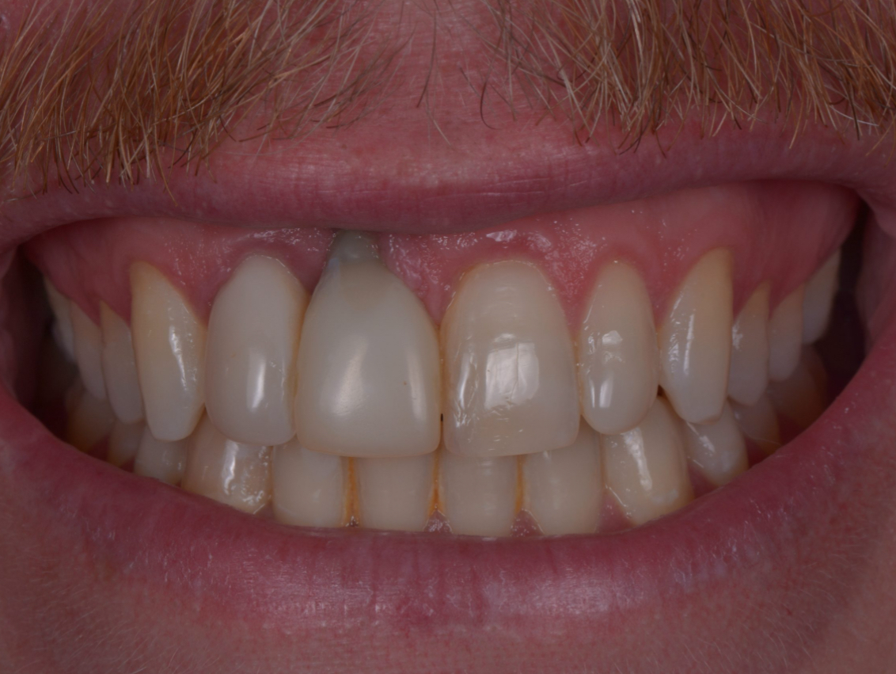
Soft tissue biology in implant dentistry
Dr Fatma Almaskari

Slide 2
Index
1.Introduction
2.Gingival Tissue and Peri-Implant Mucosa
3. Soft Tissue Aspects
4.The Need for Keratinized Tissue
4.Gingival Biotypes
5.Aesthetic Predictability
9.Grafts
10.Conclusion

Slide 3
Introduction
Prevalence and Reliability of Dental Implants:
•Widely used method for replacing missing teeth.
•Enhance chewing function and oral health-related quality of life.
Buser, Sennerby & De Bruyn (2017); Duong, Roccuzzo et al. (2022); Roccuzzo, Imber et al. (2022).
Aesthetic and Biological Considerations:
•Functional benefits are complemented by a focus on esthetic outcomes.
•Importance of the peri-implant soft tissue seal for long-term success.
Clinical Relevance:
•Understanding the biology of peri-implant soft tissues is critical for clinical outcomes.
Sculean, Gruber & Bosshardt (2014); Schwarz & Ramanauskaite (2022).

Slide 4
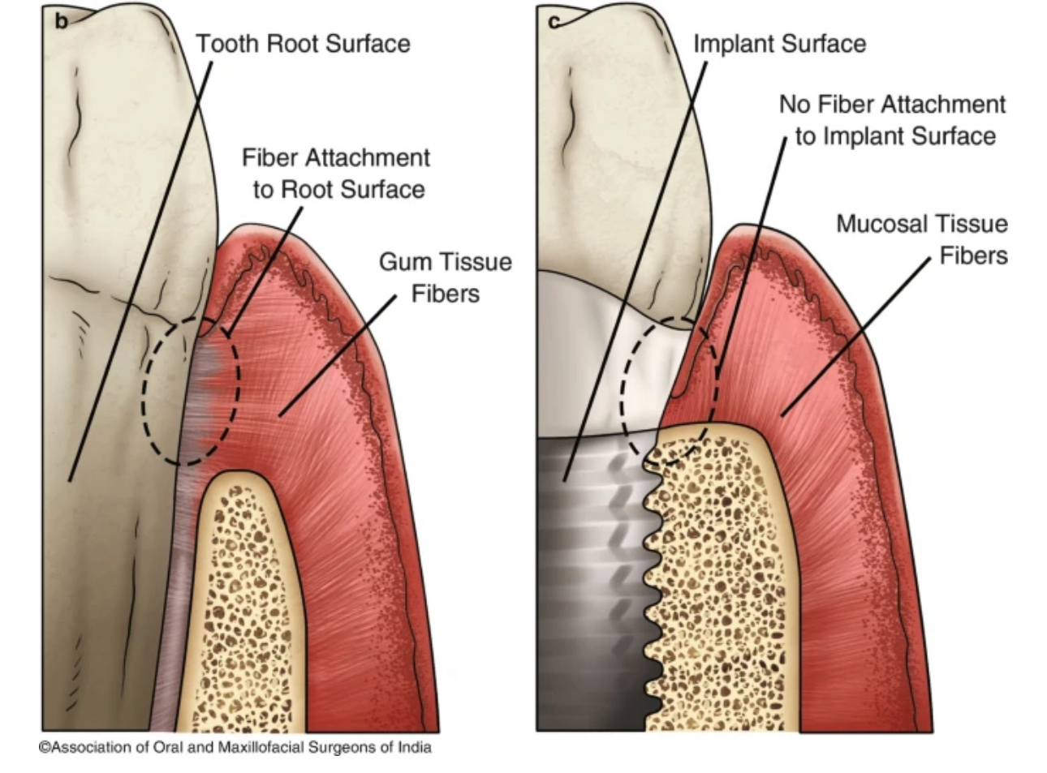
Difference Between Natural And Implant Interface

Slide 5
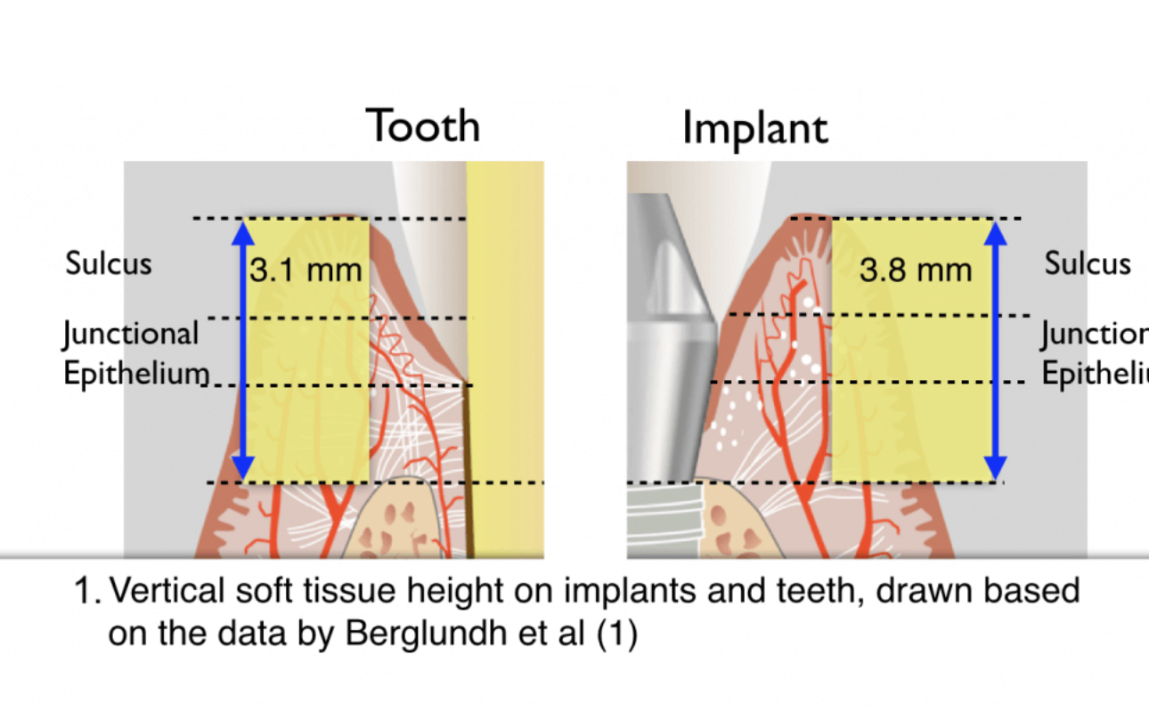
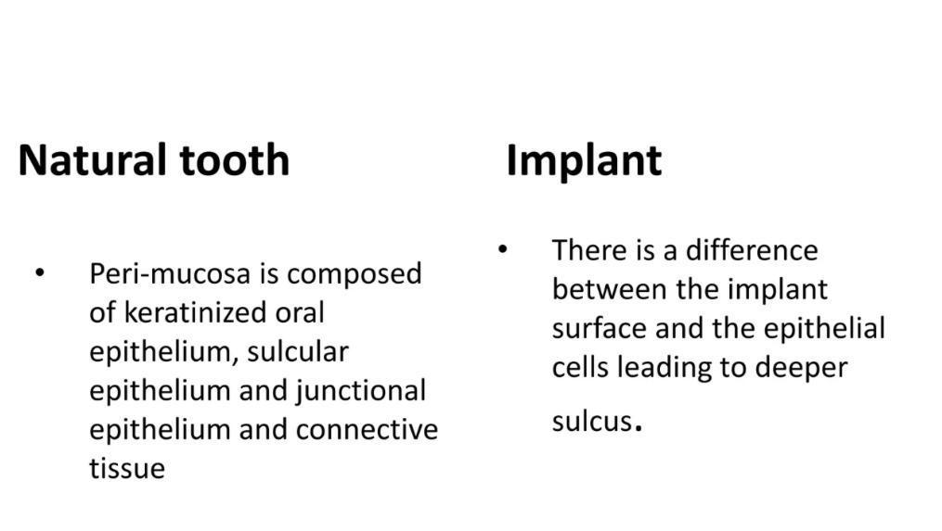

Slide 6
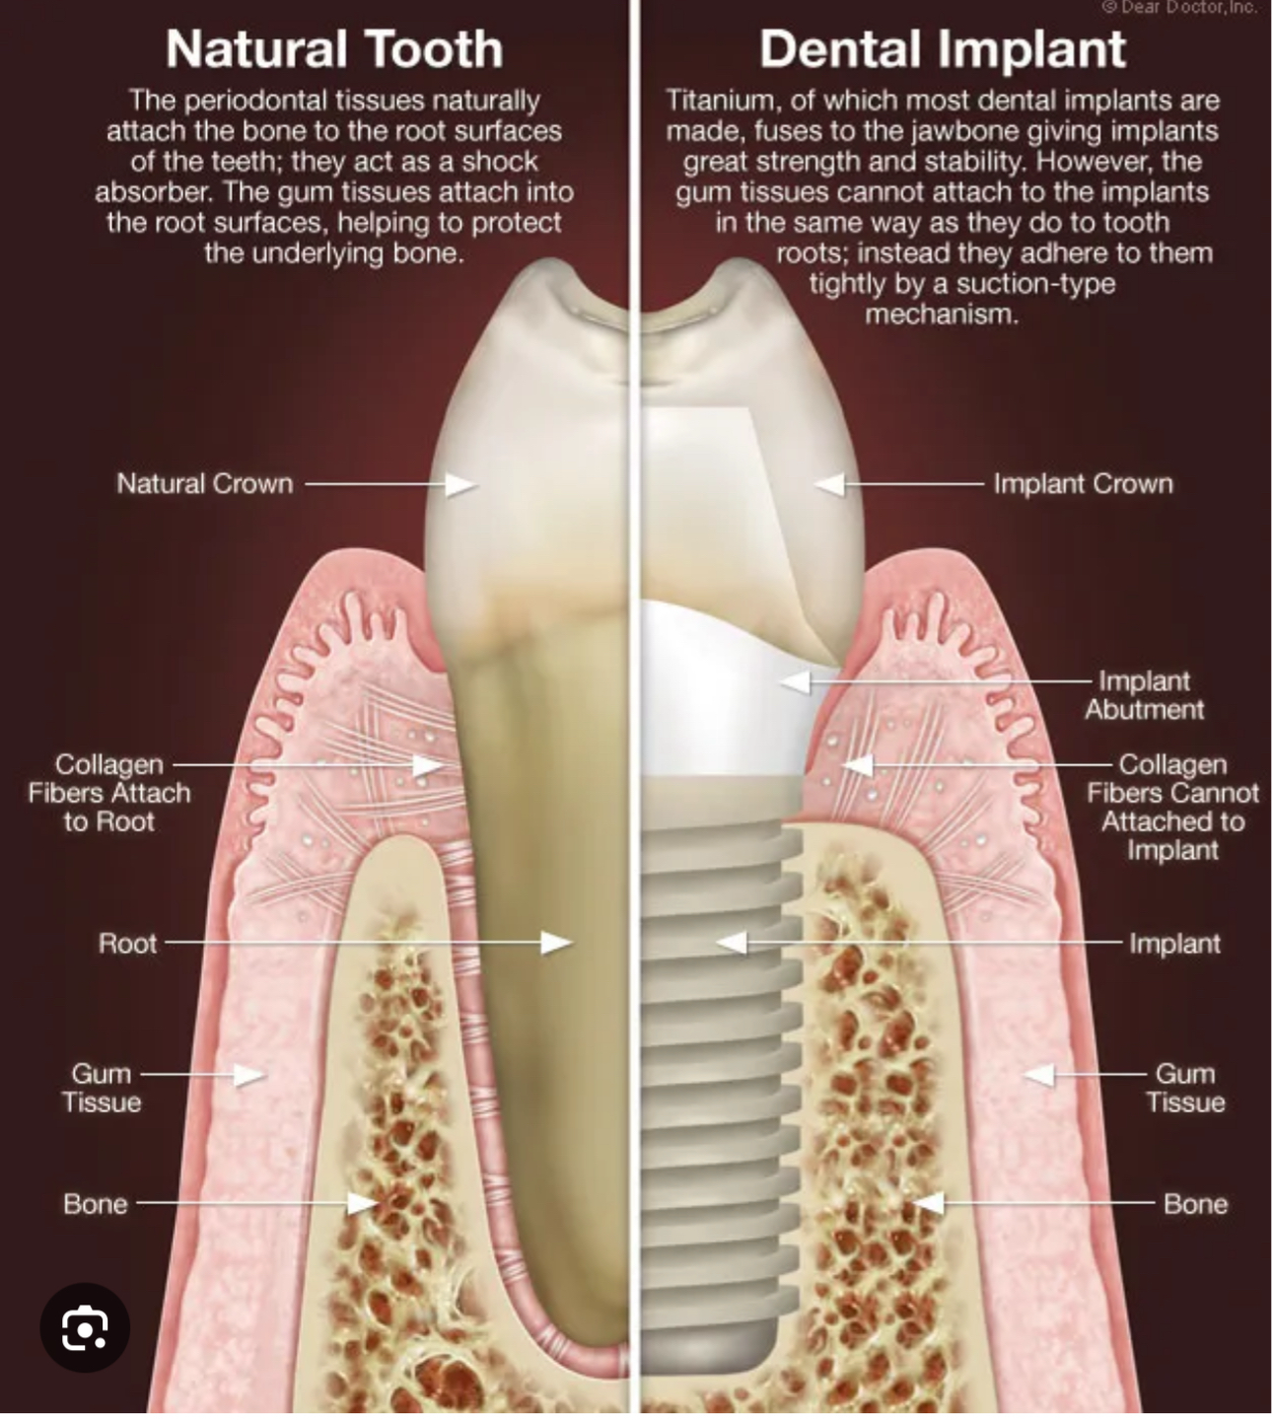
Peri-Implant Mucosa vs. Gingiva – Key Differences
Fiber Orientation
•Gingiva (Teeth): Periodontal fibers insert into the tooth cementum.
•Peri-Implant Mucosa: Connective tissue (CT) fibers run parallel to the implant/abutment surface.
Reference: Berglundh, Lindhe et al. (1991), Listgarten, Lang et al. (1991).
Cellular and Collagen Composition
•Gingiva: Higher fibroblast count and vascular content.
•Peri-Implant Mucosa: Fewer fibroblasts, higher collagen proportion (resembles scar tissue).
Reference: Moon, Berglundh et al. (1999).

Slide 7
Vascular and Elastic Fiber Differences
Vascularity
•Gingiva: Greater vascular content compared to peri-implant mucosa. •
Reference: Berglundh, Lindhe et al. (1994).
Elastic vs. Non-Elastic Fibers
•Non-Elastic Fibers: Found in keratinized tissue, responsible for gingival stability even after surgical removal.
•Elastic Fibers: Common in non-keratinized mucosa.

Slide 8
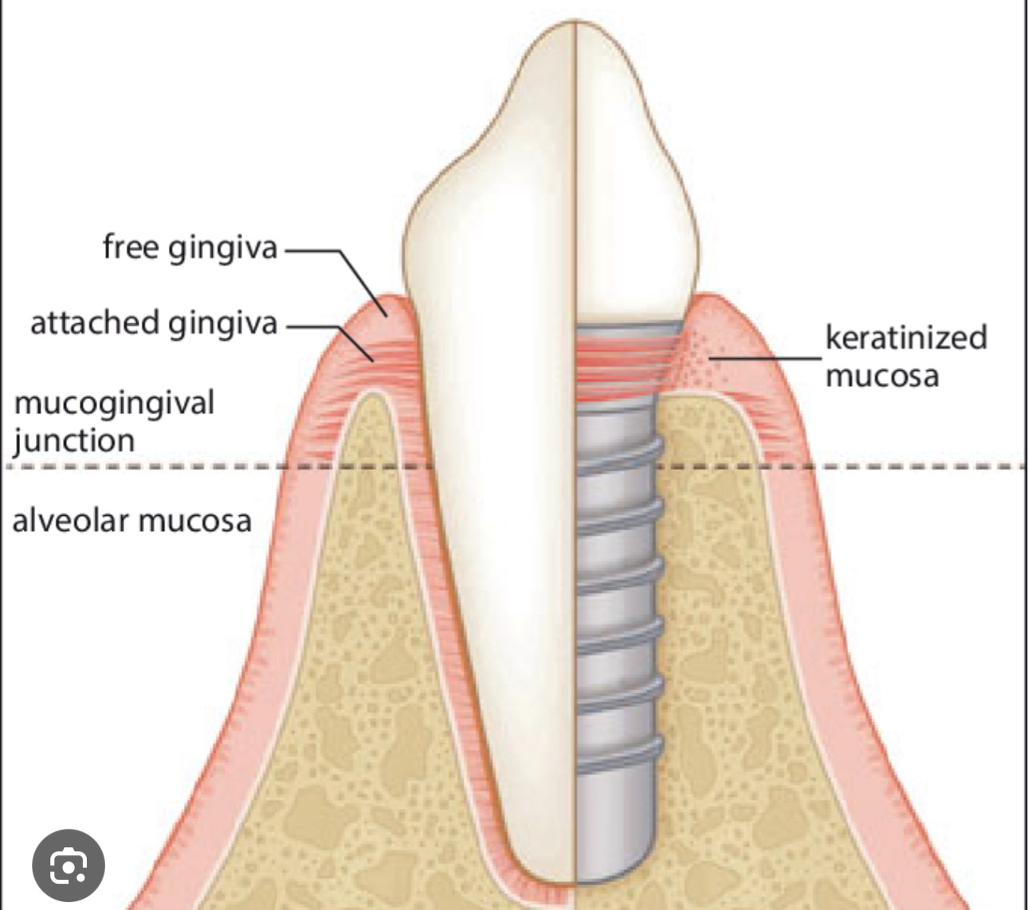
Keratinization and Attachment Differences
Gingiva (Teeth):
•Narrow band of keratinized gingiva reestablished due to non-elastic fibers in the periodontal space.
Reference: Karring, Østergaard, Löe (1971).
Peri-Implant Mucosa:
•Can consist of keratinized or movable alveolar mucosa.
•Keratinized mucosa may not attach to the underlying peri-implant bone.
Reference: Karring, Lang, Löe (1975).

Slide 9
Aspect | Gingiva (Teeth) | Peri-Implant Mucosa
Fiber Orientation | Periodontal fibers insert into tooth cementum. | Connective tissue fibers run parallel to the implant/abutment surface.
Fibroblast Content | Higher fibroblast count. | Fewer fibroblasts, resembling scar tissue.
Collagen Content | Lower collagen content compared to peri-implant CT. | Higher proportion of collagen fibers.
Vascularity | Greater vascular content. | Lower vascular content.
Elastic Fibers | Non-elastic fibers responsible for keratinized tissue. | Elastic fibers commonly found in non-keratinized mucosa.
Keratinization | Narrow band of keratinized gingiva reestablished even after surgical removal. | Keratinized or movable alveolar mucosa, not always attached to underlying bone.
Attachment | Attached to cementum and alveolar bone via periodontal ligament. | .May not attach to peri-implant bone if keratinized tissue transitions coronally.

Slide 10
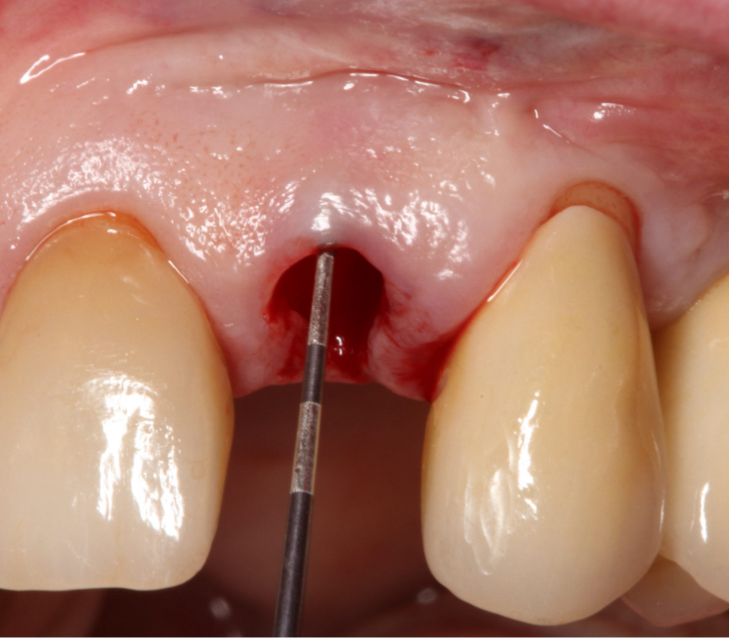
The peri-implant phenotype
Definition and Components:
•Refers to the observable characteristics of tissues surrounding osseointegrated implants.
•Includes both soft tissue and osseous components (Avila-Ortiz, Gonzalez-Martin et al., 2020).
Soft Tissue Aspects:
1.Keratinized Tissue (KT) Width:
•The distance from the soft tissue margin to the mucogingival junction.
•Influences peri-implant health and esthetics.
2.Mucosal Thickness:
•Horizontal soft tissue dimension critical for esthetic outcomes.
•May require surgical intervention for augmentation in certain cases.
3.Supracrestal Tissue Height:
•Vertical soft tissue dimension that affects bone remodeling.
•Plays a vital role in ensuring predictable implant therapy outcomes.

Slide 11
Keratinized mucosa around implants
Debate on Importance:
•The role of keratinized tissue (KT) around implants has been debated for decades.
•Some studies suggest soft tissue quality minimally affects implant survival.
•Other research highlights the benefits of adequate KT for plaque control and peri-implant health.

Slide 12
Clinical Observations and Meta-Analysis Findings:
Lack of KT is associated with:
•Increased plaque accumulation, inflammation, and attachment loss (Wu, Qu et al. 2015; Ramanauskaite, Schwarz & Sader 2022).
•Discomfort during brushing, impacting oral hygiene (Kungsadalpipob et al. 2020).
•Inflammatory responses are more pronounced around implants without KT compared to natural teeth.

Slide 13
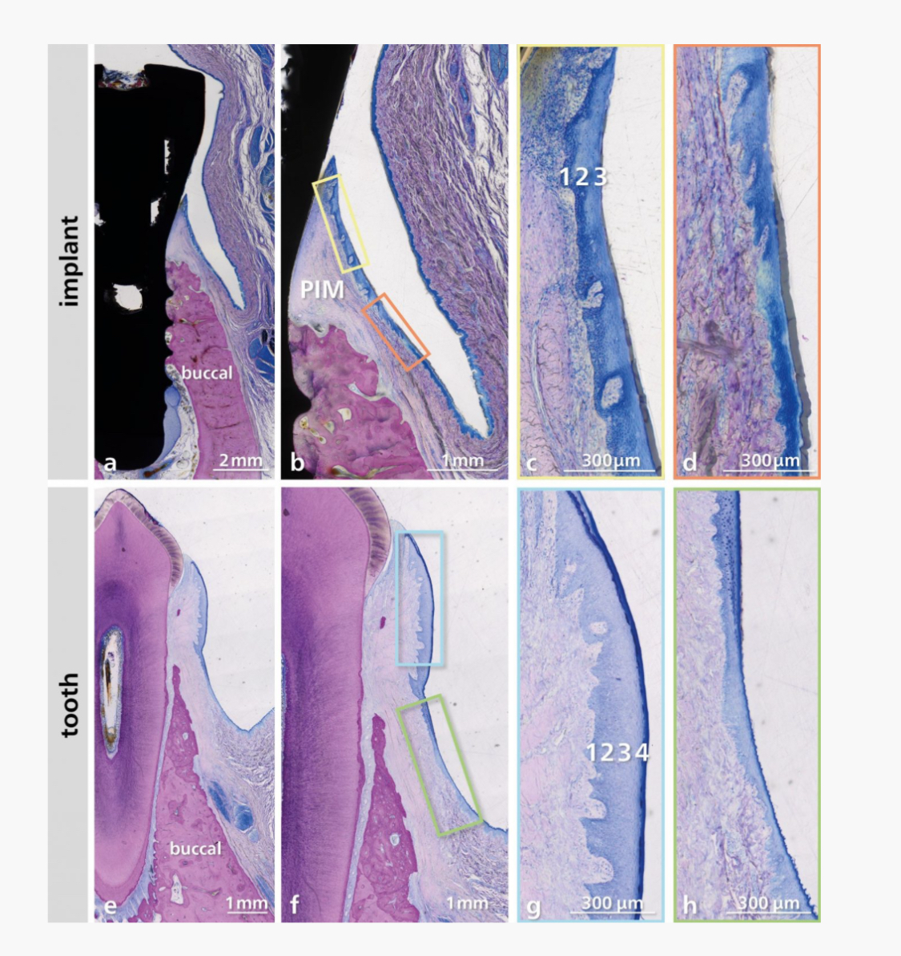
A preclinical-animal study provide valuable insights into the biological processes involved in soft tissue regeneration around dental implants compared to natural teeth (Imber et al. 2023):

Slide 14
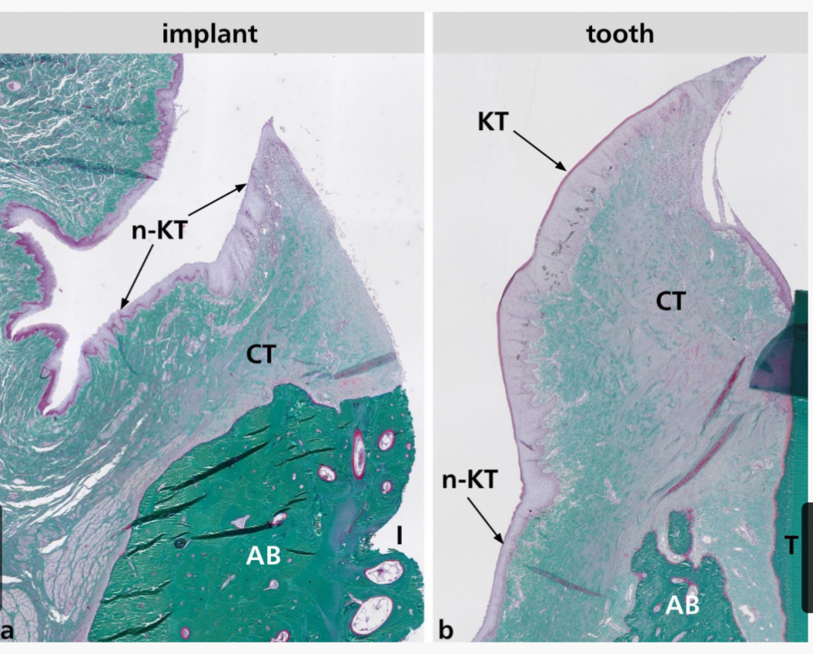
Tooth Sites:
•After healing, spontaneous regeneration of keratinized tissue occurs.
•Formation of masticatory mucosa with CT but no elastic fibers below the keratinized epithelium.
•Greater height of keratinized tissue, junctional epithelium, and supracrestal tissue height compared to implants.
Implant Sites:
•Healing results in alveolar mucosa with no keratinized tissue.
•CT contains abundant elastic fibers near and far from the mucosal margin.
•More vertical soft tissue loss (e.g., gingival recession or dehiscence).

Slide 15
Clinical Implications:
Maintaining adequate KT is essential for:
•Supporting peri-implant health and preventing complications like peri-implantitis.
•Minimizing soft tissue dehiscence and improving long-term outcomes.
Procedures such as grafting to enhance or preserve KT should be considered to maintain the soft tissue seal and optimize implant therapy.

Slide 16
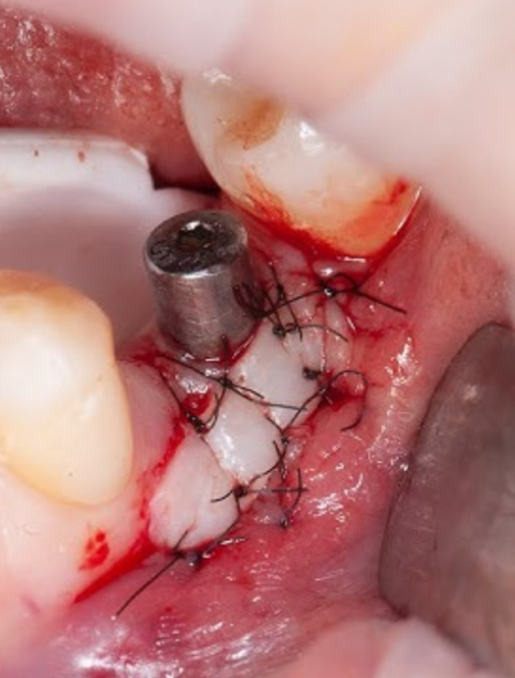
Soft tissue grafting
Soft tissue grafting procedures around dental implants encompass a variety of surgical techniques tailored to meet specific patient needs and clinical challenges.
The selection of the appropriate surgical approach depends on factors such as the extent of soft tissue deficiency, the desired outcome, and the clinician’s expertise.

Slide 17
Common Techniques:
•Vestibuloplasty, tunneling techniques, coronally advanced flaps, and guided bone regeneration (GBR) with simultaneous soft tissue grafting are frequently employed.
•Timing of augmentation can vary, including pre-implant placement, post-implant placement, or at the healing abutment connection phase (Mancini, Simeone et al. 2023).

Slide 18
Factors for Success:
•Successful outcomes depend on operator experience, implant position, patient expectations, and appropriate surgical planning.

Slide 19
Types of Grafts:
•Autogenous Grafts:
Harvested from the patient’s tissues, they are the gold standard due to excellent biocompatibility, minimal immunogenicity risk, and superior tissue integration.
Common examples include connective tissue grafts (CTG) and free gingival grafts (FGG), often sourced from the palate or tuberosity region.
•Alternatives to Autogenous Grafts:
Allografts, xenografts, and alloplastic materials offer reduced morbidity and simpler surgical procedures.

Slide 20
Clinical Considerations:
•FGG may be used to augment keratinized tissue width, while CTG enhances soft tissue thickness around implants.
•Grafting is particularly beneficial in cases where implant placement involves soft tissue challenges or when improving oral hygiene is critical.

Slide 21
Outcome Optimization:
Careful monitoring, understanding grafting principles, precise surgical execution, and incorporating ongoing research can help clinicians manage peri-implant soft tissue challenges effectively.
•Such practices ensure long-term implant success and enhanced patient satisfaction.

Slide 22
Conclusion
Understanding the characteristics of peri-implant soft tissues, their importance for implant success, and the various procedures available for managing soft tissue deficiencies are crucial for optimizing treatment outcomes and maintaining peri-implant health.

