Slide 1
TU 257 – Fundamentals of Data Science
Data Analytics
L3 – Data Exploration & Preparation
Brendan Tierney

Slide 2
Slightly ahead
Slightly behind
Second chance to understand
In more detail
reinforcement

Slide 3
Agenda
Why do we explore the data
  Understanding your Data (Good, Bad & Ugly)
Low hanging fruits
Preparing Data – You have many tools in the toolbox
  Missing Values
  Recoding Values
  Correlated Data
  Feature Engineering
  Imbalanced Data Sets
  Sampling & Subsetting the Dataset
  Splitting Data
Iterative in Nature
  You won’t get it right first time
  Experiment to see what works
No Magic Solution
A set of tools
Every Data Set is different

Slide 4
Data Wrangling module vs This Module
Pandas
Indexing
Reading files JSON, XML, web scraping etc
Writing files
Data Quality
Data Profiling
Visualisation
Data Cleaning
Data Subsetting
Data Preparation, Normalisation ,etc
Getting Data
Replacing Missing values (Imputing Values)
  Can also remove data
Recoding Data (Transforming)
  Categorical
  Numerical
Subsetting
Correlated Data
Feature Engineering
Handing Imbalanced data set
Sampling Data
Splitting Data into different data sets

Slide 5
Data Wrangling module vs This Module
Pandas
Indexing
Reading files JSON, XML, web scraping etc
Writing files
Data Quality
Data Profiling
Visualisation
Data Cleaning
Data Subsetting
Data Preparation, Normalisation ,etc
Getting Data
Replacing Missing values (Imputing Values)
  Can also remove data
Recoding Data (Transforming)
  Categorical
  Numerical
Subsetting
Correlated Data
Feature Engineering
Handing Imbalanced data set
Sampling Data
Splitting Data into different data sets

Slide 6
Get Data
Merge /
Integrate Data
Stats
Charts/Visualisations
Problem Definition
Explore & Understand
Missing Data
Recoding Data
Standardising Data Values
Data Cleaning
Categorical
Numerical
Data
Transformations
Create new Features
Splitting Features
Calculations based on other Features
Data
Engineering
Feature
Reduction
Sampling
Data
Splitting
Data

Slide 7
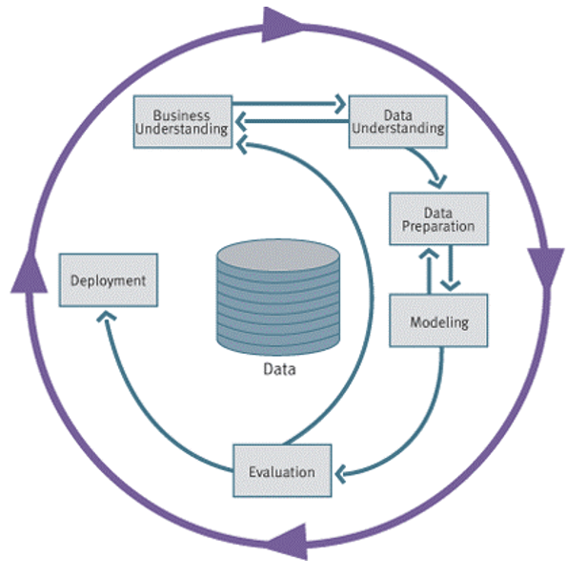

Slide 8

Phase 2 – Data Understanding
Business
Understanding
Data
Understanding
Data
Preparation
Modeling
Evaluation
Deployment
Collect
Initial
Data
Acquire the data
Explore the data (query & visualization)
Verify the quality
Starts with an initial data collection and proceeds with activities in order to get familiar with the data, to identify data quality problems, to discover first insights into the data or to detect interesting subsets to form hypotheses for hidden information.
Describe
Data
Explore
Data
Data
Quality Plan

Slide 9
Phase 3 – Data Preparation
Business
Understanding
Data
Understanding
Data
Preparation
Modeling
Evaluation
Deployment
Select
Data
Data preparation:
  Collection
  Assessment
  Consolidation and Cleaning
    table links, aggregation level, missing values, etc
  Data selection
    active role in ignoring non-contributory data?
    outliers?
    Use of samples
    visualization tools
  Transformations - create new variables
Covers all activities to construct the final dataset from the initial raw data. Data preparation tasks are likely to be performed multiple times and not in any prescribed order. Tasks include table, record and attribute selection as well as transformation and cleaning of data for modeling tools.
Clean
Data
Construct
Data
Integrate
Data
Format
Data

Slide 10
Why do we explore the data ?

Slide 11
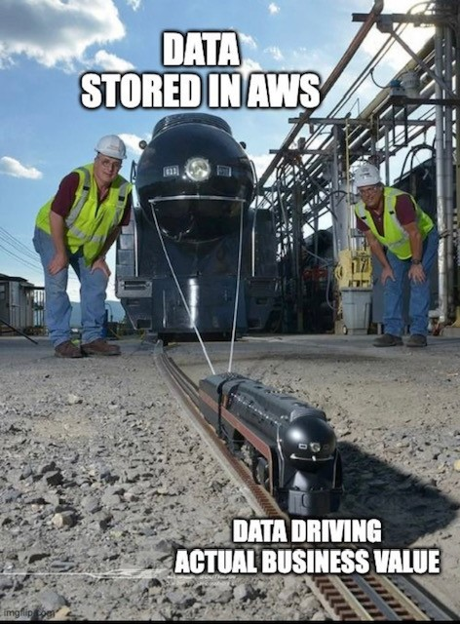
Need to know and understand you Data
What Data do you have? (easy access to)
What Data would you like to have?
Not always possible to have all the data you want !
You will never need ALL the data – Big Data isn’t a problem
  What is Big Data Really!
Get to know your data
Data Audit
Data Quality Report
Remember
Automated Data Exploration?
Using Different Pandas functions?

Slide 12
What you have vs What you don’t have
How clean is the data vs how dirty it is
How consistent the data is vs how inconsistent it is
  Particularly when you merge data from different sources
Is data available from one Data Source vs How many different Data Sources
  In most cases, Data will come from different Data Sources
  Different Data Sources => Differences in Data formats, values, representations
    All of these need to be cleaned up, to make it consistent.
You’d think data in your Enterprise is clean, consistent, good quality, etc
  It generally isn’t

Slide 13
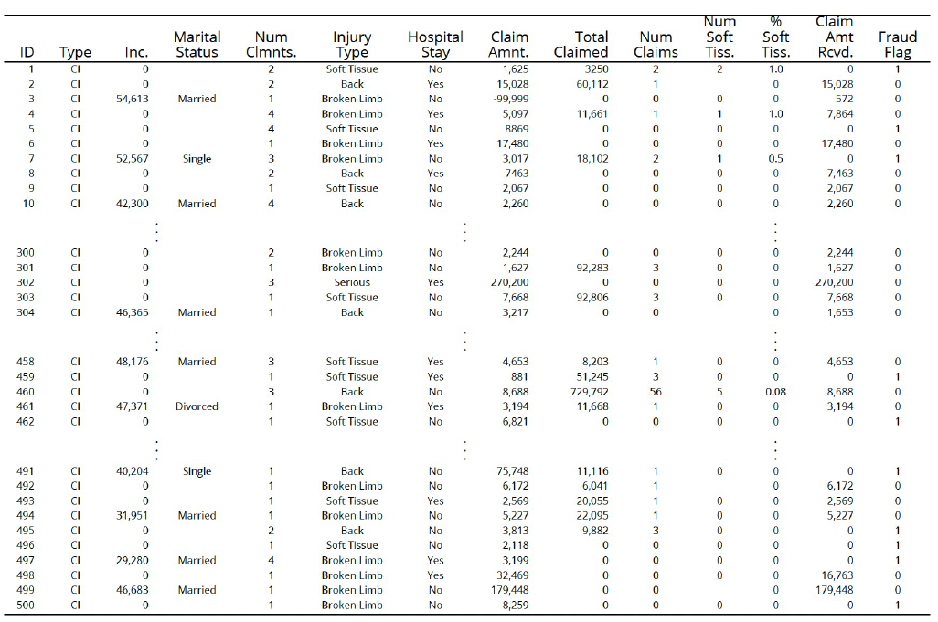
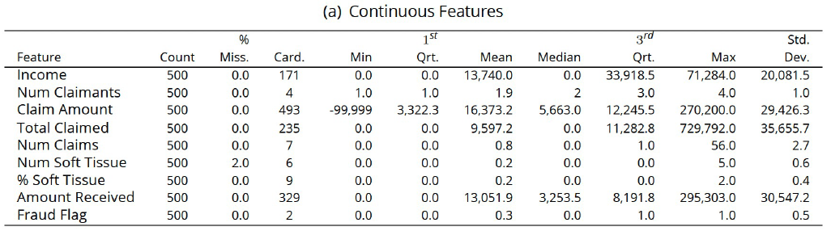
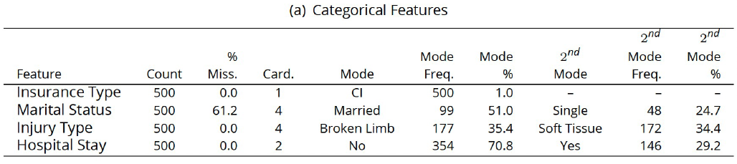
Data Audit & Quality Report
A data quality report includes tabular reports that describe the characteristics of each feature (column)
The tabular reports are accompanied by data visualizations:
  A histogram for each continuous feature.
  A bar plot for each categorical feature.
Plus charts/graphs of each feature

Slide 14
Data Audit & Quality Report
Have you seen something like this before?
Automated Data Exploration – Remember example and exercises from last week

Slide 15
Explore the Data
What patterns do you see?
Can you connect any Domain Knowledge to the patterns you are seeing?
  Nothing magical with doing this
  Nobody or thing will tell you the meaning of these patterns
  It is your job to make the connections
Start Building a Picture of what is happening in the Data & what work needs to be done to the data
  Iterate to improve your understanding

Slide 16
Low hanging fruits

Slide 17

Pick the Low Hanging Fruits
All too often people look to use advanced and unnecessary algorithms, tools, approaches etc. Before doing the simple and basic things
Most of the valuable Data Insights can be achieved by examining the data
See what patterns you have
Can you related to Domain Knowledge or Certain Events
Discuss with Business Users
Can be used to Verify existing Knowledge & Identify new Knowledge
Can be iterative
  Can generate more questions from Business for you to explore in Data
  Can identify more questions for Business to clarify and verify

Slide 18
Pick the Low Hanging Fruits
Identify Patterns
Can these be converted into Rules
Can you prioritise these Rules
Create IF…THEN
Eg. Car Insurance industry – Claims
  Age profile
  Driving experience
  Type of Car
  Value of Car
  Job
  Service History
  Payment Schedule
By analysing this data you can identify certain patterns in the data?
Based on your Domain Knowledge, can you identify possible Rules/Patterns?
These would need to be verified with the Business.

Slide 19

Data Sets available online vs Real World
Most/All Data Sets online you get are Clean-ish
Most of what we will cover in remaining slides are examples of things you need to look out for.
  Even if the Data Set seems clean, you still need to check and verify it.
In Real World data sets, you can spend a lot of time merging and cleaning the data (using what is covered in remaining slides
  80+% of project time

Slide 20

Know your Tool/Product
Most Enterprise BI/DM/ML/AI solutions – Do these automatically
    Automate the boring stuff
Most FREE products don’t - R, Python, Julia, Spark, etc
    Needs to be manually coded! Boring! Wastes a lot of time! Expensive for Businesses
    Mistakes can happen

Slide 21
Preparing Data – You have many tools in the toolbox

Slide 22




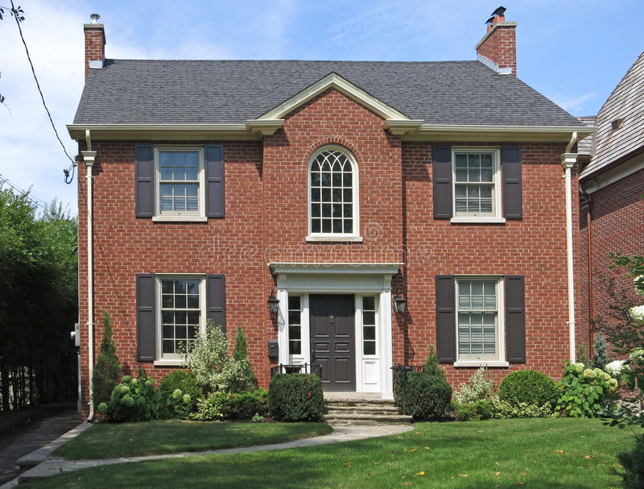

Your Toolbox

Slide 23


Your Toolbox
From Basics
to Experienced
Takes Time
& Practice

Slide 24
Explore your Data

Slide 25
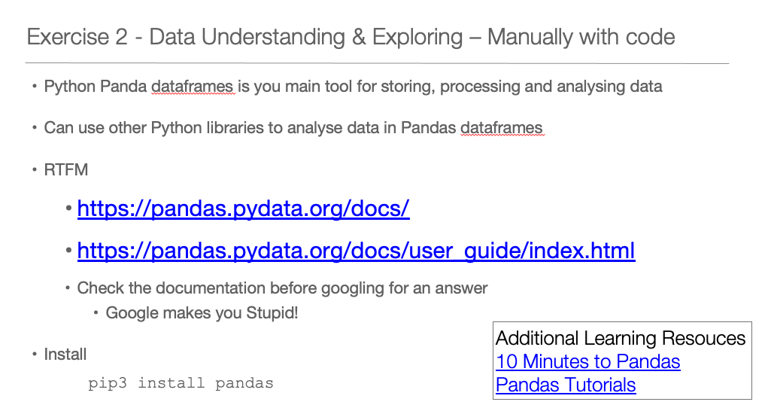
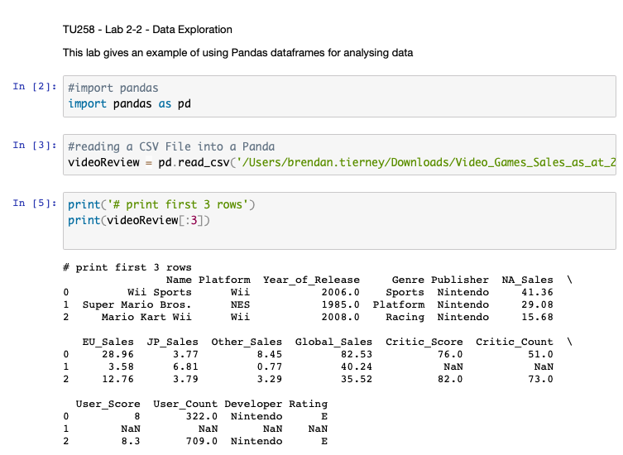
Last Week Lab Exercise

Slide 26
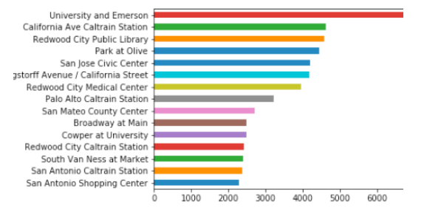
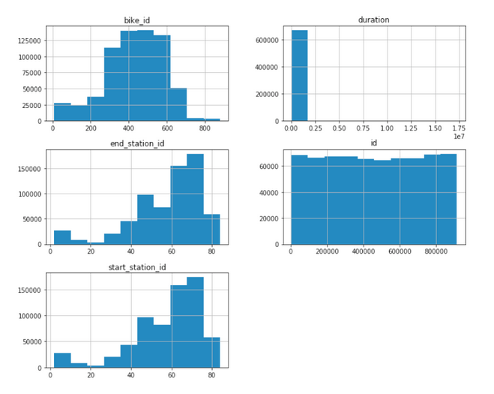
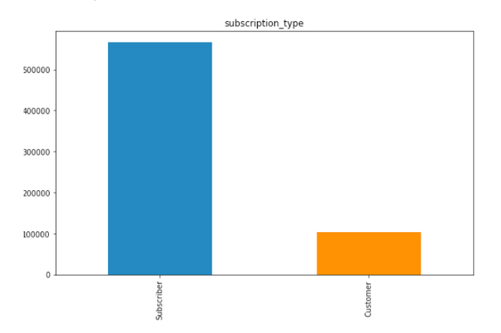

Slide 27
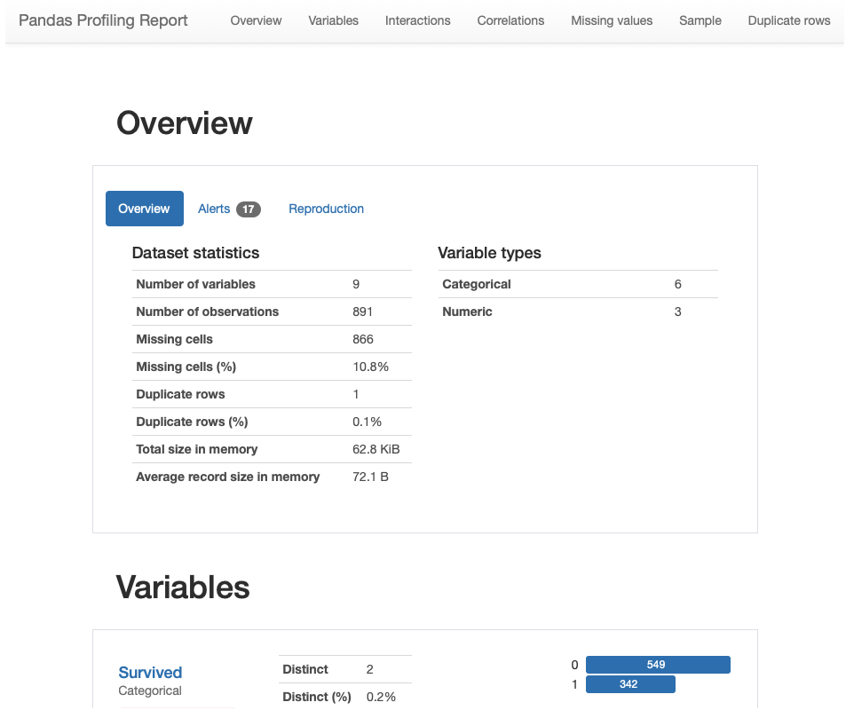
We also have automated data exploration/profiling
import pandas_profiling as pp
df2.profile_report()

Slide 28
Handing Missing Data

Slide 29
Data can be Dirty
Data in the real world is dirty
  Incomplete: lacking attribute values, lacking certain attributes of interest, or containing only aggregate data
    e.g., occupation=“”
    Comes from
      N/A data value when collected
      Different consideration between the time when the data was collected and when it is analyzed
      Human/hardware/software problems
      N/A may have a meaning
  Noisy: containing errors or outliers
    e.g., Salary=“-10”
    Comes from
      Collection
      Entry
      Transmission
  Inconsistent: containing discrepancies in codes or names
    e.g., Age=“42” Birthday=“03/07/1997”
    e.g., Was rating “1,2,3”, now rating “A, B, C”
    e.g., discrepancy between duplicate records
    Comes from
      Different data sources
      Functional dependency violation

Slide 30
Missing Data
Reasons for missing values
  Information is not collected
  (e.g., people decline to give their age and weight)
  Attributes may not be applicable to all cases
  (e.g., annual income is not applicable to children)
    E.g. many tuples have no recorded value for several attributes, such as customer income in sales data
Missing data may be due to:
  Equipment malfunction
  Inconsistent with other recorded data and thus deleted
  Data not entered due to misunderstanding
  Certain data may not be considered important at the time of entry
  Not registering history or changes of the data
Handling missing values
  Eliminate Data Objects
  Estimate Missing Values
  Ignore the Missing Value During Analysis
  Replace with all possible values (weighted by their probabilities)

Slide 31
Missing Data
Your data set could have missing data
These will be missing values in the features/columns
Algorithms don’t like missing values
We need to fix these
How
  If a Row/Record has a lot of missing values -> Delete it
    As it will be just filled with defaults (see below)
  If a Feature/Column has a lot of missing values -> Drop it, as it won’t contribute to any analysis
  Calculate (Impute) possible missing value -> Mean, Mode, Median
  Calculate (Impute) possible missing value -> Based on some calculation of one or more Features/Columns
  Replace with some default value

Slide 32
Fixing Missing Data
#Replace missing values with Zero
#Does this for all Columns in dataframe
df = df.fillna(0)
#Or for one Column
# replace 'DataFrame Column' witl name of column
df['DataFrame Column'] = df['DataFrame Column'].fillna(0)
#example - replace with default value
df.country.fillna("Unknown")
#Check to see if a column contains nulls
df[pd.isnull(df.country)]

Slide 33
Fixing Missing Data
#Alternatively, we may have a non-null value that we would like to replace
df.taster_twitter_handle.replace("@kerinokeefe", "@kerino")
df = df.replace(['NO DATA','N/A', 0, ’’], np.nan)
df = df.replace(['NO DATA','N/A', 0, ’’], ”Unknown")
The replace() method is worth mentioning here because it's handy for replacing missing data which is given some kind of sentinel value in the dataset: things like "Unknown", "Undisclosed", "Invalid", and so on.

Slide 34
Fixing Missing Data
Method 1: Fill NaN Values in One Column with Mean
df['col1'] = df['col1'].fillna(df['col1'].mean())
Method 2: Fill NaN Values in Multiple Columns with Mean
df[['col1', 'col2']] = df[['col1', 'col2']].fillna(df[['col1', 'col2']].mean())
Method 3: Fill NaN Values in All Columns with Mean
df = df.fillna(df.mean())

Slide 35
Recoding Data (Transformations)
Categorical & Numerical

Slide 36
Cleaning Data
Data set may include data objects that are duplicates, or almost duplicates of one another
  Major issue when merging data from heterogeous sources
Can also be same data item entered in a different way
  Free format text
Examples:
  Same person with multiple email addresses
Data cleaning
  Process of dealing with duplicate data issues
Exercise – Get out a Pen and Paper / type up the following

Slide 37
Data Cleaning Problem
Write the full work address for Brendan Tierney. (I’ll call it out and you can write it down)
  Type up what I’ve called out
When you have finished -> Put it in the Chat window
Share with class
Do you get the same as everyone else?

Slide 38
Data Cleaning Problem
Write the full work address for Brendan Tierney
brendan tierney
school of computing science
technological university dublin
grangegorman
dublin 7
ireland
Brendan Tierney
School of Computing Science
Technological University Dublin
Grangegorman
Dublin 7
Ireland
Brendan Tierney,
School of Computing Science,
Technological University Dublin,
Grangegorman,
Dublin 7,
Ireland.
Brendan Tierney,
School of Computing Science,
Technological University Dublin,
Grangegorman,
D7,
Ireland.
Brendan Tierney,
School of Computing Science,
Technological University Dublin,
Grangegorman,
Dublin 7,
Ire.
There are lots and lots of other combinations. All of these are different.

Slide 39
Converting Data
Lots and Lots of possibilities here
We will only cover some of these now
  Others will be covered in Data Wangling module
  Others we will covered throughout the semester in this module
Generally – Data Analytics algorithms do not like attributes/features in Text format
  Convert to numerical
Numerical Data -> Some formatting is needed

Slide 40
Converting Text Data
Some examples include:
  A “pet” variable with the values: “dog” and “cat“.
  A “color” variable with the values: “red“, “green” and “blue“.
  A “place” variable with the values: “first”, “second” and “third“.
Possible approaches
  One Hot Coding
  Find/Replace (Manual Coding)
  Label Encodings
Everyone has the own favourite way of doing these things
New approaches, libraries, code etc are coming available all the time
The above are quick and easy for you to get started
Let’s have a look at an example of each

Slide 41
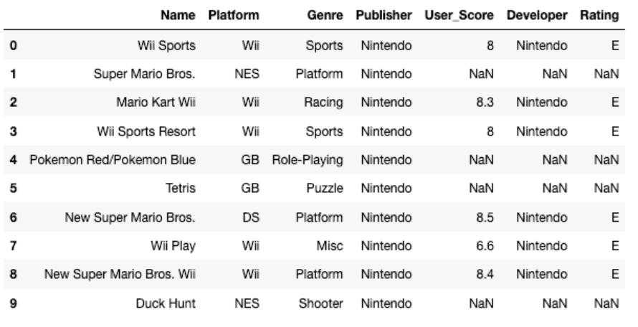
One-Hot Coding
Creates a new attribute/feature for each distinct value
  If a categorical variable has 5 values, then 5 new attributes/features will be created
import pandas as pd
import numpy as np
import matplotlib as plt
videoReview = pd.read_csv('/Users/brendan.tierney/Downloads/Video_Games_Sales_as_at_22_Dec_2016.csv')
videoReview.head(10)

Slide 42
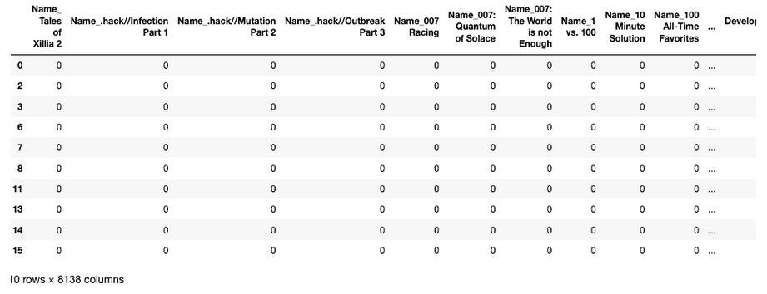
One-Hot Coding
#apply one-hot-coding to all the categorical variables
# and create a new dataframe to store the results
df2 = pd.get_dummies(df)
df2.head(10)
Lots of additional attributes/features
Lots containing Zeros
Might not be suitable for data sets with a large number of distinct categorical attributes
Original data set had 7 attributes/features

Slide 43
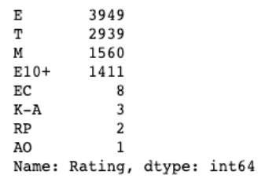
Find/Replace (Manual Coding)
You can create a new attribute/feature and write code to do mapping to numeric
df['Rating'].value_counts()
The last 4 values listed have very small number of occurrences.
We will group these into having one value/category
find_replace = {"Rating" : {"E": 1, "T": 2, "M": 3, "E10+": 4, "EC": 5, "K-A": 5, "RP": 5, "AO": 5}}
df.replace(find_replace, inplace=True)
df.head(10)
Using same data set as previous example

Slide 44
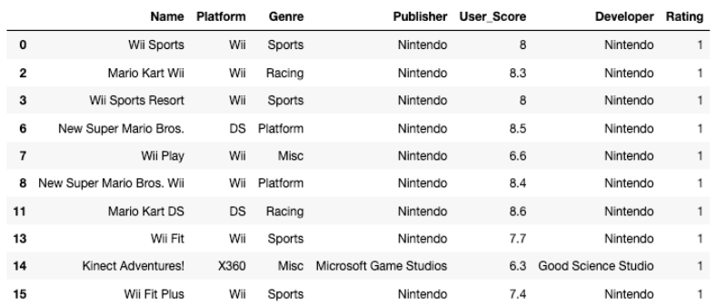
Find/Replace (Manual Coding)
You have greater control over what is created
Fewer attributes/features needed
More understanding of the data needed, and on how data can be greuped
More coding needed

Slide 45
Label Encodings
With this technique where each distinct value in a categorical variable is converted to a number.
In this scenario you don’t get to pick the numeric value assigned to the value. It is system determined.
Our categorical variables are of ‘object’ data type. We need to convert to a category data type.
In this example ‘Platform’ has a large-ish number of values and we want a quick way of converting them we can illustrate this by creating a new variable.
df["Platform_Category"] = df["Platform"].astype('category')
df.dtypes
Now convert this new variable to numeric.
df["Platform_Category"] = df["Platform_Category"].cat.codes
df.head(20)

Slide 46
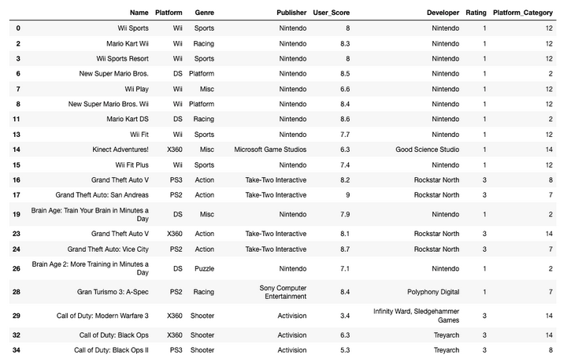
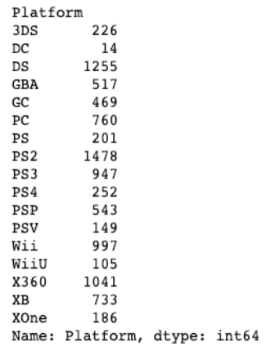
The number assigned to the Platform_Category variable is based on the alphabetical ordering of the values in the Platform variable. For example,
df.groupby("Platform")["Platform"].count()

Slide 47
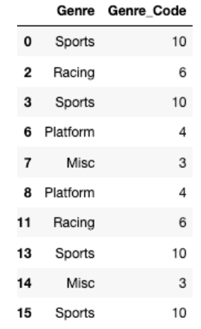
Label Encodings – Using SciKit-Learn
SciKit-Learn has a number of functions to help with data encodings. The first one we will look at is the ‘fit_transform’ function.
This will perform a similar task to what we have seen in a previous example
#Let's use the fit_tranforms function to encode the Genre variable
from sklearn.preprocessing import LabelEncoder
le_make = LabelEncoder()
df["Genre_Code"] = le_make.fit_transform(df["Genre"])
df[["Genre", "Genre_Code"]].head(10)

Slide 48
What about Numerical Data
Normalization is a technique often applied as part of data preparation for machine learning.
The goal of normalization is to change the values of numeric columns in the dataset to use a common scale, without distorting differences in the ranges of values or losing information.
For example, assume your input dataset contains one column with values ranging from 0 to 1, and another column with values ranging from 10,000 to 100,000. The great difference in the scale of the numbers could cause problems when you attempt to combine the values as features during modeling
There are several approaches to this (experimentation needed to determine), common ones are:
  Min-Max Scaling: Subtract the min value from each column’s highest value and divide by the range.
  Standardization Scaling: Subtracting the mean of each observation and dividing by the standard deviation

Slide 49
What about Numerical Data
Example Data
  Salaries
  Temperatures
  Prices
  Salaries
  Sales
  Populations
All have ranges from Zero to some large number
Convert to common scale to allow the algorithms to compare
  Otherwise the attributes/features with larger numbers will have a greater influence to those attributes with small variables
  The algorithms may use these attributes incorrectly, and the models produced may not be the best

Slide 50
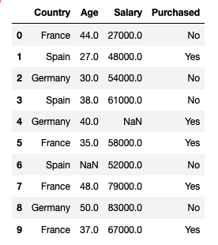
import pandas as pd
import numpy as np
import seaborn as sns
import matplotlib.pyplot as plt
from sklearn.preprocessing import MinMaxScaler
data.head(10)
# <-- See results to the left
scaler = MinMaxScaler()
data[['Age', 'Salary']] = scaler.fit_transform(data[['Age', 'Salary']])
data

Slide 51
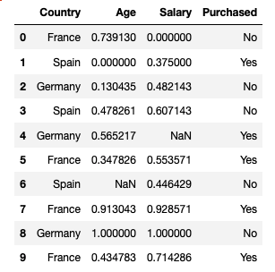
import pandas as pd
import numpy as np
import seaborn as sns
import matplotlib.pyplot as plt
from sklearn.preprocessing import MinMaxScaler
data.head(10)
# <-- See results to the left
scaler = MinMaxScaler()
data[['Age', 'Salary']] = scaler.fit_transform(data[['Age', 'Salary']])
data

Slide 52
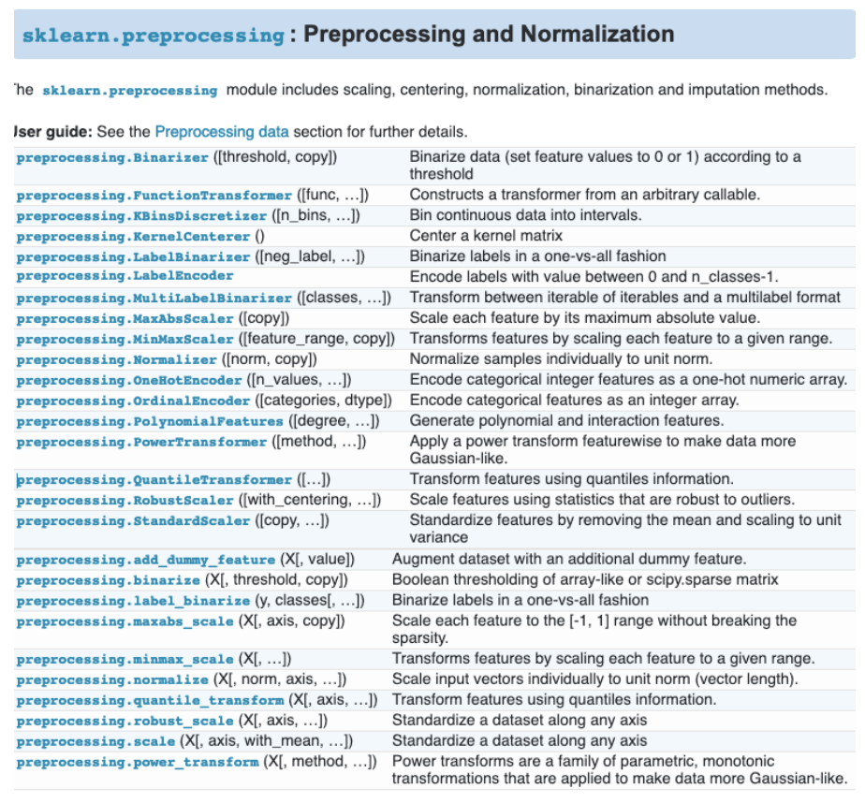
Lots of functions available
Lots of options
Remember to Keep It Simple
Start Simple and with the basics
As your knowledge and experience grows, explore some of the others

Slide 53
Correlated Data

Slide 54
Correlated Data
Correlation explains how one or more variables are related to each other.
If two variables are closely correlated, then we can predict one variable from the other
Examples
  Income and Expenditure of an individual
  Demand and price of a commodity
  Age and Insurance Claims
Why is this important?
  Can help clean up the data set
  Reduce/Remove variables that are highly correlated
    As they indicate the same thing, meaning, outcome, etc

Slide 55
Correlated Data
A supermarket is beginning to offer a new line of organic products. The supermarket’s management would like to determine which customers are likely to purchase these products.
The supermarket has a customer loyalty program. As an initial buyer incentive plan, the supermarket provided coupons for the organic products to all of their loyalty program participants and has now collected data that includes whether or not these customers have purchased any of the organic products.
Name | Model Role | Measurement Level | Description
CUSTID | ID | Nominal | Customer loyalty identification number
GENDER | Input | Nominal | M = male, F = female, U = unknown
DOB | Input | Interval | Date of birth
EDATE | Input | Unary | Date extracted from the daily sales data base
AGE | Input | Interval | Age, in years
AGEGRP1 | Input | Nominal | Age group 1
AGEGRP2 | Input | Nominal | Age group 2
TV_REG | Input | Nominal | Television region
NGROUP | Input | Nominal | Neighborhood group
NEIGHBORHOOD | Input | Nominal | Type of residential neighborhood
LCDATE | Input | Interval | Loyalty card application date
LTIME | Input | Interval | Time as loyalty card member
ORGANICS | Input | Interval | Number of organic products purchased
BILL | Input | Interval | Total amount spent
REGION | Input | Nominal | Geographic region
CLASS | Input | Nominal | Customer loyalty status: tin, silver, gold, or platinum
ORGYN | Input | Binary | Organics purchased? 1 = Yes, 0 = No
AFFL | Input | Interval | Affluence grade on a scale from 1 to 30

Slide 56
Correlated Data
A supermarket is beginning to offer a new line of organic products. The supermarket’s management would like to determine which customers are likely to purchase these products.
The supermarket has a customer loyalty program. As an initial buyer incentive plan, the supermarket provided coupons for the organic products to all their loyalty program participants and has now collected data that includes whether or not these customers have purchased any of the organic products.
Name | Model Role | Measurement Level | Description
CUSTID | ID | Nominal | Customer loyalty identification number
GENDER | Input | Nominal | M = male, F = female, U = unknown
DOB | Input | Interval | Date of birth
EDATE | Input | Unary | Date extracted from the daily sales data base
AGE | Input | Interval | Age, in years
AGEGRP1 | Input | Nominal | Age group 1
AGEGRP2 | Input | Nominal | Age group 2
TV_REG | Input | Nominal | Television region
NGROUP | Input | Nominal | Neighborhood group
NEIGHBORHOOD | Input | Nominal | Type of residential neighborhood
LCDATE | Input | Interval | Loyalty card application date
LTIME | Input | Interval | Time as loyalty card member
ORGANICS | Input | Interval | Number of organic products purchased
BILL | Input | Interval | Total amount spent
REGION | Input | Nominal | Geographic region
CLASS | Input | Nominal | Customer loyalty status: tin, silver, gold, or platinum
ORGYN | Input | Binary | Organics purchased? 1 = Yes, 0 = No
AFFL | Input | Interval | Affluence grade on a scale from 1 to 30
ORGANICS and ORGYN are highly correlated

Slide 57
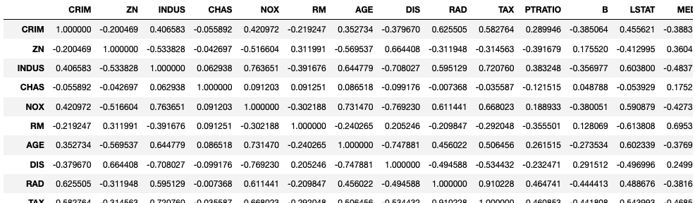
import pandas as pd
#read in the data set
data = pd.read_csv('/Users/brendan.tierney/Dropbox/4-Datasets/boston-housing-dataset.csv’)
corr_matrix=data.corr()
corr_matrix

Slide 58
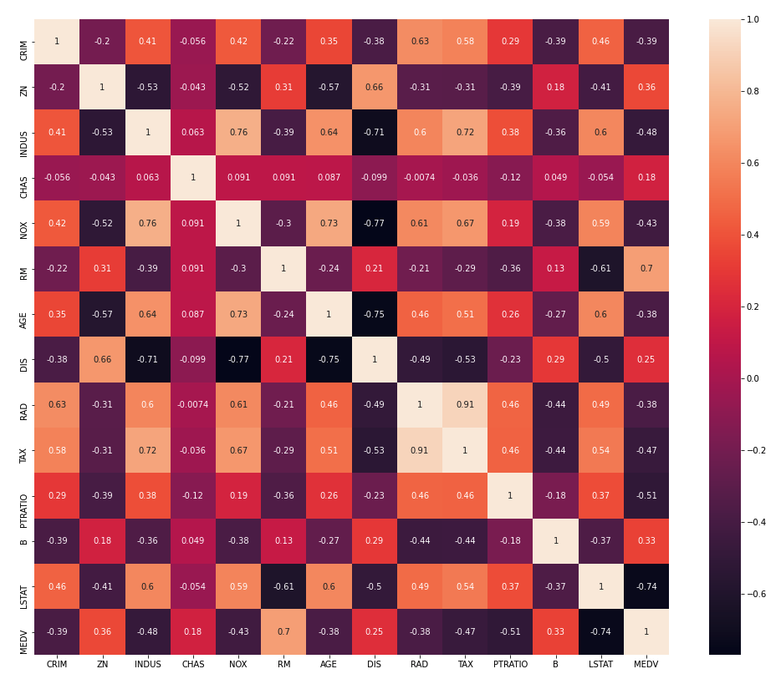
import pandas as pd
#read in the data set
data = pd.read_csv('/Users/brendan.tierney/Dropbox/4-Datasets/boston-housing-dataset.csv’)
corr_matrix=data.corr()
corr_matrix
import seaborn as sn
fig = plt.subplots(figsize=(17,14))
sn.heatmap(corr_matrix, annot=True)
"tax" and "rad" columns are highly correlated with value of 0.91(positive correlation).
Some of the features are negatively correlated and their correation value is negatively high. Such as "lstat" vs "medv", "dis" vs "indus", "dis" vs "age".
From the above observations, we can conclude that there is hidden covariation between the tax rate and the index of accessibility to radial highways.
We can derive a relationship that if the house accessibility to highways is high then the full-value property-tax rate will also be higher.
This may sound like a genuine thing, because of the houses with high price generally nearer to market, good amenities, highways, etc.

Slide 59
Splitting Data, Sampling and Final Steps

Slide 60

Are we nearly there?
Yes we are :-)
The finals steps are really dependent on what you will do next
  What visualisations
  What Tools
  What Languages
  What Algorithms
  What APIs, web services, functions

Slide 61
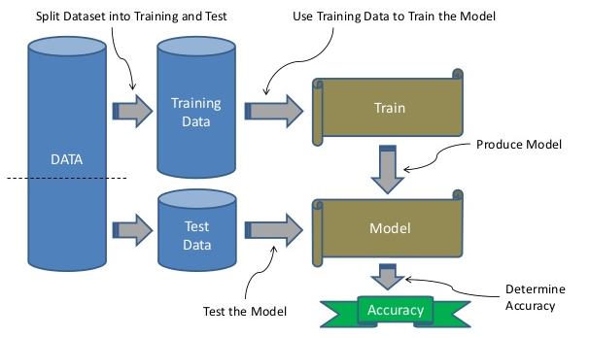
For Supervised Machine Learning
e.g. Classification, Regression
Training Data set
  Used to create the ML Model
  Representative of entire data
Testing Data set
  Use for testing the ML Model
  How good is it at making predictions
  How many predictions are correct
  How many predictions it got wrong
70-30 split
60-40 split

Slide 62
Example – train_test_split
Will split the data set into 2 different dataframes
Needs to have one of test_size or train_size defined, in range 0 to 1.0
from sklearn.model_selection import train_test_split
training_data, testing_data = train_test_split(df, test_size=0.2, random_state=25)
2 Data Sets are created
  Test Data Set will contain 20% of records, as defined by parameter
  Training Data Set will contain 80% of records, calculated by default from test_size parameter
Limitation might result in Training and Test not having representative numbers of each Target value

Slide 63
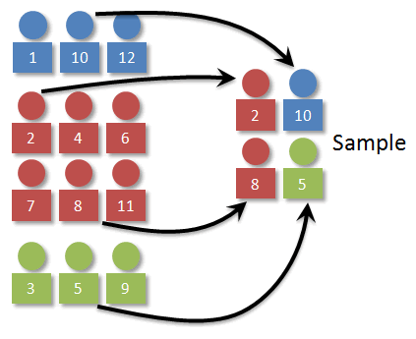
Example – Using proportional sampling
Stratified Sampling
Divide the population into subgroups or into strata, and instances are sampled from each stratum to guarantee that the test set is representative of the entire population.
Stratified sampling is different from simple random sampling, which involves the random selection of data from the entire population so that each possible sample is equally likely to occur.
A random sample is taken from each stratum in direct proportion to the size of the stratum compared to the population, so each possible sample is equally likely to occur.

Slide 64
from sklearn.model_selection import train_test_split
training_data, testing_data = train_test_split(df, test_size=0.2, random_state=25, stratify=y)

Slide 65
Example – Using proportional sampling
#After the data is prepared, we can now divide the data into the Training and Test data sets.
import random
random.seed(3434200)
# use Stratified sampling to divide the data
from sklearn.model_selection import StratifiedShuffleSplit
split = StratifiedShuffleSplit(n_splits=10, test_size = 0.2, random_state=18)
for train_index, test_index in split.split(df_new, df_new['y']):
train_set = df_new.loc[train_index]
test_set = df_new.loc[test_index]
Stratified Sampling ensure proportional representation in each sub-group
Notes:
N_splits = The data set is shuffled at the beginning, then split into N folds, before random sampling

Slide 66
Example – Using proportional sampling
#After the data is prepared, we can now divide the data into the Training and Test data sets.
import random
random.seed(3434200)
# use Stratified sampling to divide the data
from sklearn.model_selection import StratifiedShuffleSplit
split = StratifiedShuffleSplit(n_splits=10, test_size = 0.2, random_state=18)
for train_index, test_index in split.split(df_new, df_new['y']):
train_set = df_new.loc[train_index]
test_set = df_new.loc[test_index]
Stratified Sampling ensure proportional representation in each sub-group

Slide 67
#Calculate the distributions for each of the Target variables. We have an imbalanced data set.
df['y'].value_counts() # dataset is imbalanced with majority of class label as "no".
no 36548
yes 4640
df['y'].value_counts()/len(df) #calculate percentages
no 0.887346
yes 0.112654
#Check the sizes of the Training and Test data sets.
train_set['y'].value_counts()
0 29238
1 3712
train_set['y'].value_counts()/len(train_set)
0 0.887344
1 0.112656
#Check the Test data set
test_set['y'].value_counts()
0 7310
1 928
test_set['y'].value_counts()/len(test_set)
0 0.887351
1 0.112649
Stratified Sampling ensure proportional representation in each sub-group

Slide 68
For Un-Supervised Machine Learning
e.g. Clustering, Association Rules Analysis, Text Mining, Forecasting, etc
Nothing more to do
All done
Just pass the data set (dataframe) into the algorithms

Slide 69
Imbalanced Data Sets

Slide 70
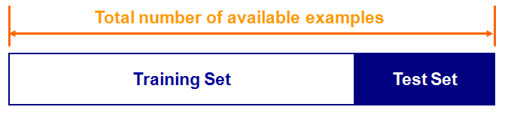
For Classification & Regression Algorithms
For Classification & Regression Algorithms
They look to learn how the attributes and their values contribute towards the Target attribute
Need to have enough examples or records of each value of Target attribute
Split the available data into a training set and a test set
Train the classifier in the training set and evaluate based on the test set
A couple of drawbacks
  We may not have enough data
  We may happen upon an unfortunate split

Slide 71
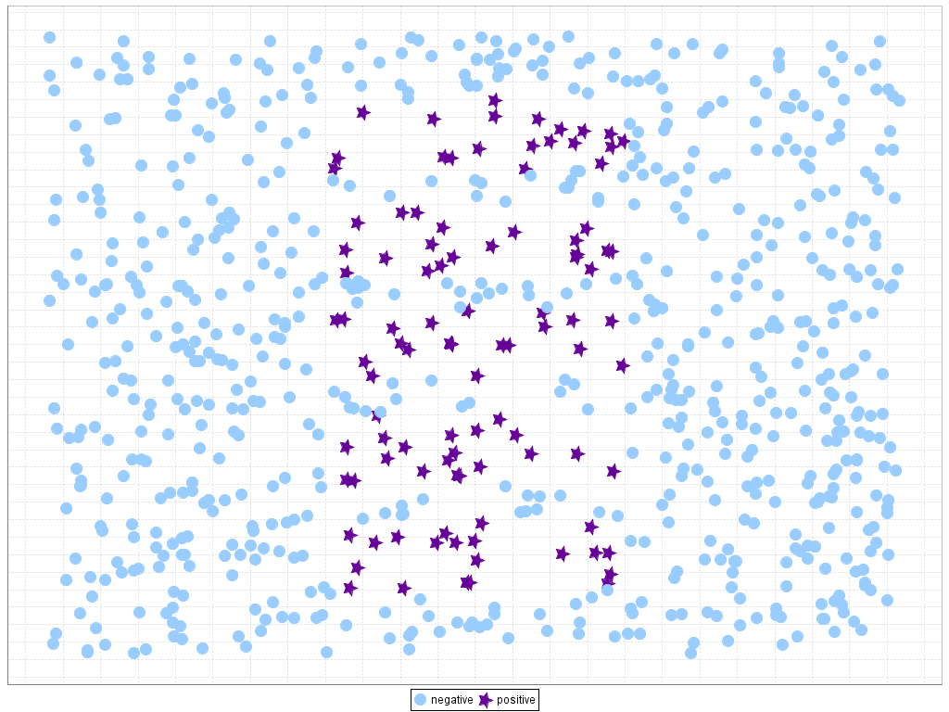
Imbalanced Data Sets
One Target value has more than the other
Not a problem if difference is small
If we use the data => a biased model
  It will be good at predicting one of the Target values
  And rubbish at predicting the other value
Customer Churn
Data Set
< 10%
> 90%

Slide 72
Imbalanced Data Sets
Typically, One Target value has more than the other
  Very common in real world
  Typically want to predict the smaller “thing”
Not a problem if differences in Target attribute (in number of records) is small
If we use the Imbalanced data set => a biased model
  It will be good at predicting one of the Target values (most number of records)
  And rubbish at predicting the other value (lower number of records
Customer Churn
Data Set
< 10%
> 90%

Slide 73
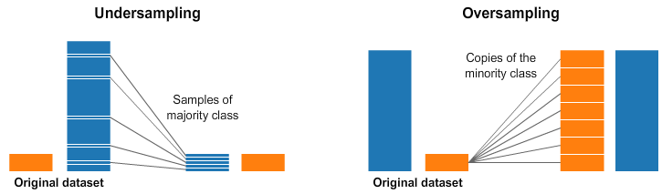
How to manage Imbalanced Data Sets
Under Sample
  Remove records from data set
  Random (but how random is it really)
    How can you ensure representative samples remain.
    May end up removing important cases
Issues with reducing
the size of data set

Slide 74
How to manage Imbalanced Data Sets
Over Sample
  Repeat/Duplicate records - Quick and Easy, by has Limitations (biases, no-variances, etc)
  SMOTE: Synthetic Minority Over-sampling Technique
  take a sample from the dataset, and consider its k nearest neighbors (in feature space). To create a synthetic data point, take the vector between one of those k neighbors, and the current data point. Multiply this vector by a random number x which lies between 0, and 1. Add this to the current data point to create the new, synthetic data point. Allows for possible data variations, within current ranges.

Slide 75
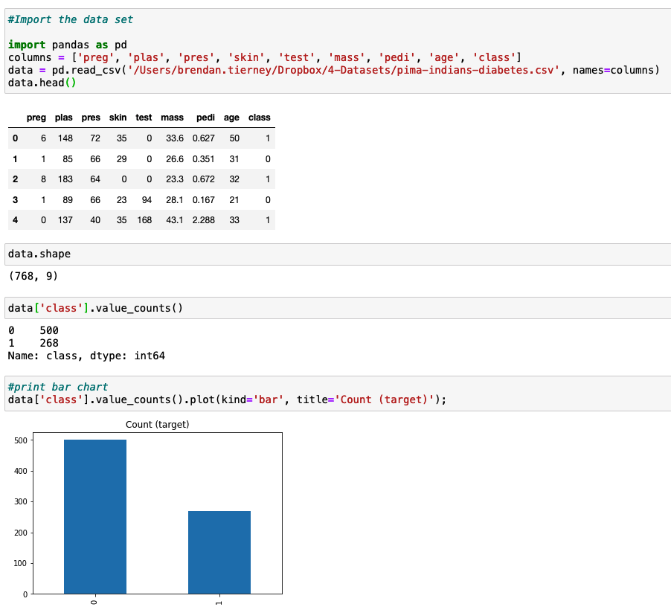

Slide 76
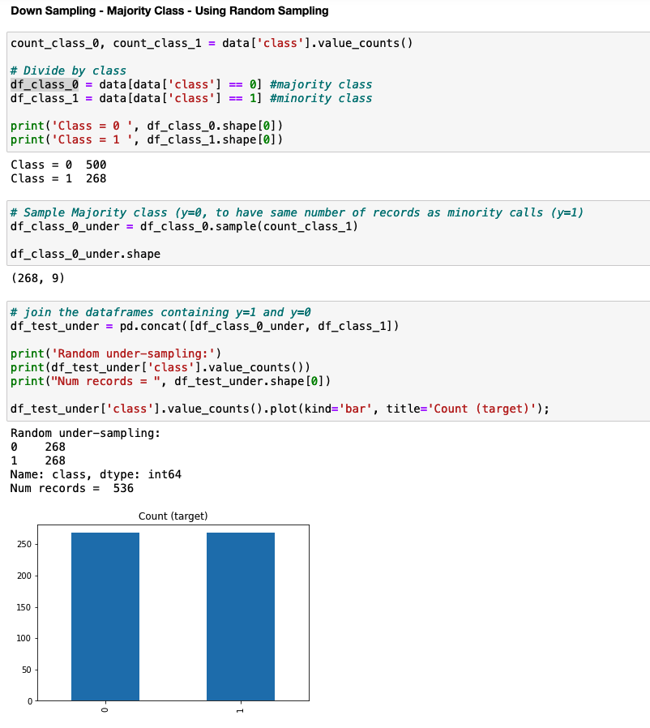

Slide 77
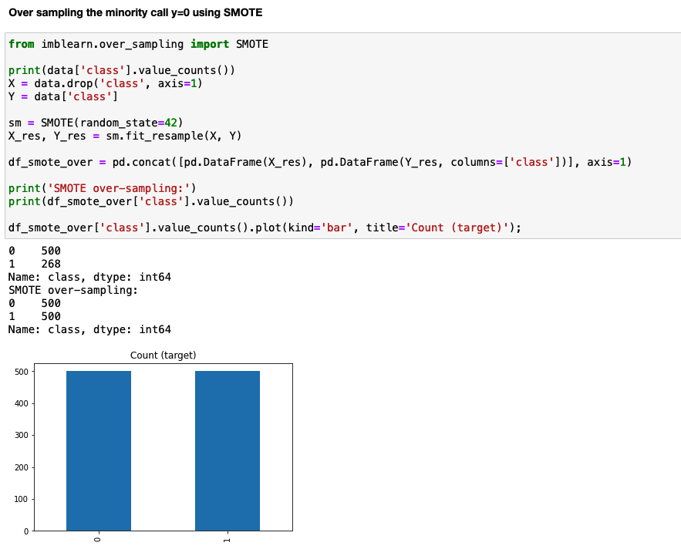

Slide 78
Iterative in Nature

Slide 80
Get Data
Merge /
Integrate Data
Stats
Charts/Visualisations
Problem Definition
Explore & Understand
Missing Data
Recoding Data
Standardising Data Values
Data Cleaning
Categorical
Numerical
Data
Transformations
Create new Features
Splitting Features
Calculations based on other Features
Data
Engineering
Feature
Reduction
80+% of project time
Sampling
Data
Splitting
Data

Slide 81


Slide 82

Data Leakage
Data leakage is when information from outside the training dataset is used to create the model.
Your Data Set contains features which were created after the Event your data set represents.
Your Data Set contains records that represent an Event.
  Details of Customer leading up to them Buying a Product
  Customer details leading up to them being involved in a Marketing Campaign
Examples
  How long did it take for the Customer to Buy their next product
  Did the customer Buy the product
  How long were they on the Call
    the longer the call the more likely (correlated) to buying the product
    The shorter the call means they didn’t buy

Slide 83
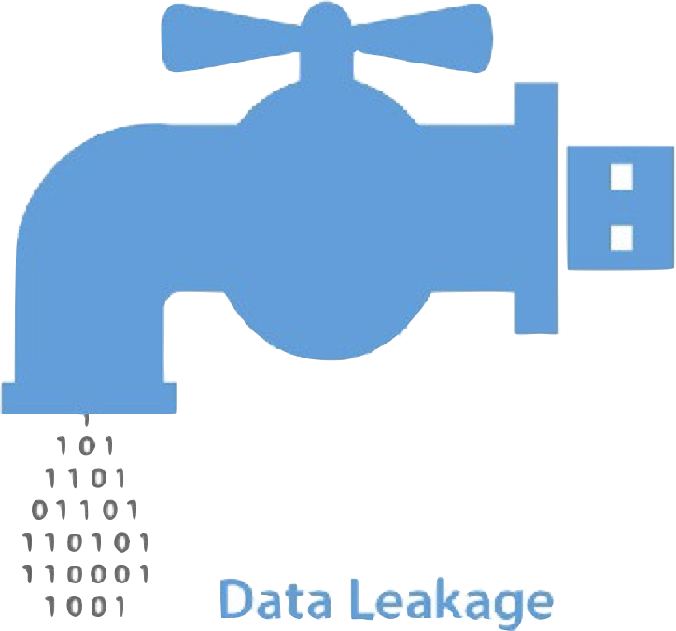
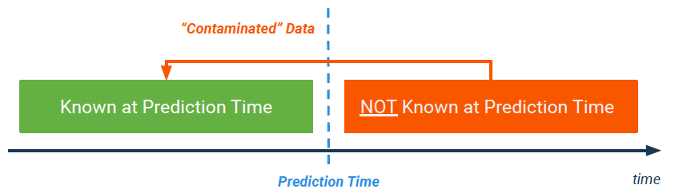
Data Leakage
Data Leakage can be applied to many different types of problems
For Data Science/Mining etc it refers to data quality issue
It can affect the Analysis, Data Understanding, Visualisations, Models, Interoperation of results, etc
(Target) Data Leakage happens if you train your model on information that would NOT be available at the point in time when you use the model in production to score newly collected data

Slide 84
Data Leakage
Less common if you are building the data set yourself
Can be very common in publicly available Data Sets.
Always check the Meta-Data / Data Dictionary.
  And any other information provided for the Data Set.
Remove these features from the Data Set.
These features Might appear as Strong indicators in Machine Learning models.

Slide 85
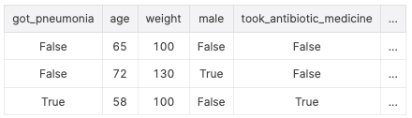
Data Leakage
For example, imagine you want to predict who will get sick with pneumonia.

Slide 86
Data Leakage - Example
Bank Marketing Data Set - https://archive.ics.uci.edu/ml/datasets/bank+marketing
1 - age (numeric)
2 - job : t ype of job (categorical: 'admin.','blue-collar','entrepreneur','housemaid','management','retired','self-employed’, 'services’, 'student’, 'technician’, 'unemployed’, 'unknown')
3 - marital : marital status (categorical: 'divorced','married','single','unknown'; note: 'divorced' means divorced or widowed)
4 - education (categorical: 'basic.4y','basic.6y','basic.9y','high.school','illiterate','professional.course','university.degree','unknown')
5 - default: has credit in default? (categorical: 'no','yes','unknown')
6 - housing: has housing loan? (categorical: 'no','yes','unknown')
7 - loan: has personal loan? (categorical: 'no','yes','unknown')
# related with the last contact of the current campaign:
8 - contact: contact communication type (categorical: 'cellular','telephone')
9 - month: last contact month of year (categorical: 'jan', 'feb', 'mar', ..., 'nov', 'dec')
10 - day_of_week: last contact day of the week (categorical: 'mon','tue','wed','thu','fri')
11 - duration: last contact duration, in seconds (numeric).
# other attributes:
12 - campaign: number of contacts performed during this campaign and for this client (numeric, includes last contact)
13 - pdays: number of days that passed by after the client was last contacted from a previous campaign (numeric; 999 means client was not previously contacted)
14 - previous: number of contacts performed before this campaign and for this client (numeric)
15 - poutcome: outcome of the previous marketing campaign (categorical: 'failure','nonexistent','success')
# social and economic context attributes
16 - emp.var.rate: employment variation rate - quarterly indicator (numeric)
17 - cons.price.idx: consumer price index - monthly indicator (numeric)
18 - cons.conf.idx: consumer confidence index - monthly indicator (numeric)
19 - euribor3m: euribor 3 month rate - daily indicator (numeric)
20 - nr.employed: number of employees - quarterly indicator (numeric)
Output variable (desired target):
21 - y - has the client subscribed a term deposit? (binary: 'yes','no')
Do we have an example of
Data Leakage in this Data Set?
Example the information and
come up with a possible features

Slide 87
Data Leakage - Example
Bank Marketing Data Set - https://archive.ics.uci.edu/ml/datasets/bank+marketing
1 - age (numeric)
2 - job : t ype of job (categorical: 'admin.','blue-collar','entrepreneur','housemaid','management','retired','self-employed’, 'services’, 'student’, 'technician’, 'unemployed’, 'unknown')
3 - marital : marital status (categorical: 'divorced','married','single','unknown'; note: 'divorced' means divorced or widowed)
4 - education (categorical: 'basic.4y','basic.6y','basic.9y','high.school','illiterate','professional.course','university.degree','unknown')
5 - default: has credit in default? (categorical: 'no','yes','unknown')
6 - housing: has housing loan? (categorical: 'no','yes','unknown')
7 - loan: has personal loan? (categorical: 'no','yes','unknown')
# related with the last contact of the current campaign:
8 - contact: contact communication type (categorical: 'cellular','telephone')
9 - month: last contact month of year (categorical: 'jan', 'feb', 'mar', ..., 'nov', 'dec')
10 - day_of_week: last contact day of the week (categorical: 'mon','tue','wed','thu','fri')
11 - duration: last contact duration, in seconds (numeric). Important note: this attribute highly affects the output target (e.g., if duration=0 then y='no'). Yet, the duration is not known before a call is performed. Also, after the end of the call y is obviously known. Thus, this input should only be included for benchmark purposes and should be discarded if the intention is to have a realistic predictive model.
# other attributes:
12 - campaign: number of contacts performed during this campaign and for this client (numeric, includes last contact)
13 - pdays: number of days that passed by after the client was last contacted from a previous campaign (numeric; 999 means client was not previously contacted)
14 - previous: number of contacts performed before this campaign and for this client (numeric)
15 - poutcome: outcome of the previous marketing campaign (categorical: 'failure','nonexistent','success')
# social and economic context attributes
16 - emp.var.rate: employment variation rate - quarterly indicator (numeric)
17 - cons.price.idx: consumer price index - monthly indicator (numeric)
18 - cons.conf.idx: consumer confidence index - monthly indicator (numeric)
19 - euribor3m: euribor 3 month rate - daily indicator (numeric)
20 - nr.employed: number of employees - quarterly indicator (numeric)
Output variable (desired target):
21 - y - has the client subscribed a term deposit? (binary: 'yes','no')

Slide 88
df = df.drop('duration', axis=1)

Slide 89
Your Toolbox
Lots of possible tasks to do
Sometimes it can be a little confusing what you need to do
Keep it Simple. Iterate. Built upon. Learn
Start simple and learn/experiment
We haven’t covered all possibilities
But we have covered more than enough to get started
Build and Learn from each example

Slide 90
Any Questions ?
What Now/Next ?

