Slide 1
Warba AI Chat
Jun 2023

Slide 2
Outline:
Introduction
Initiating Project
Data Scope
Proposal
Examples
Future For Warba AI
Opportunity for Warba Bank

Slide 3
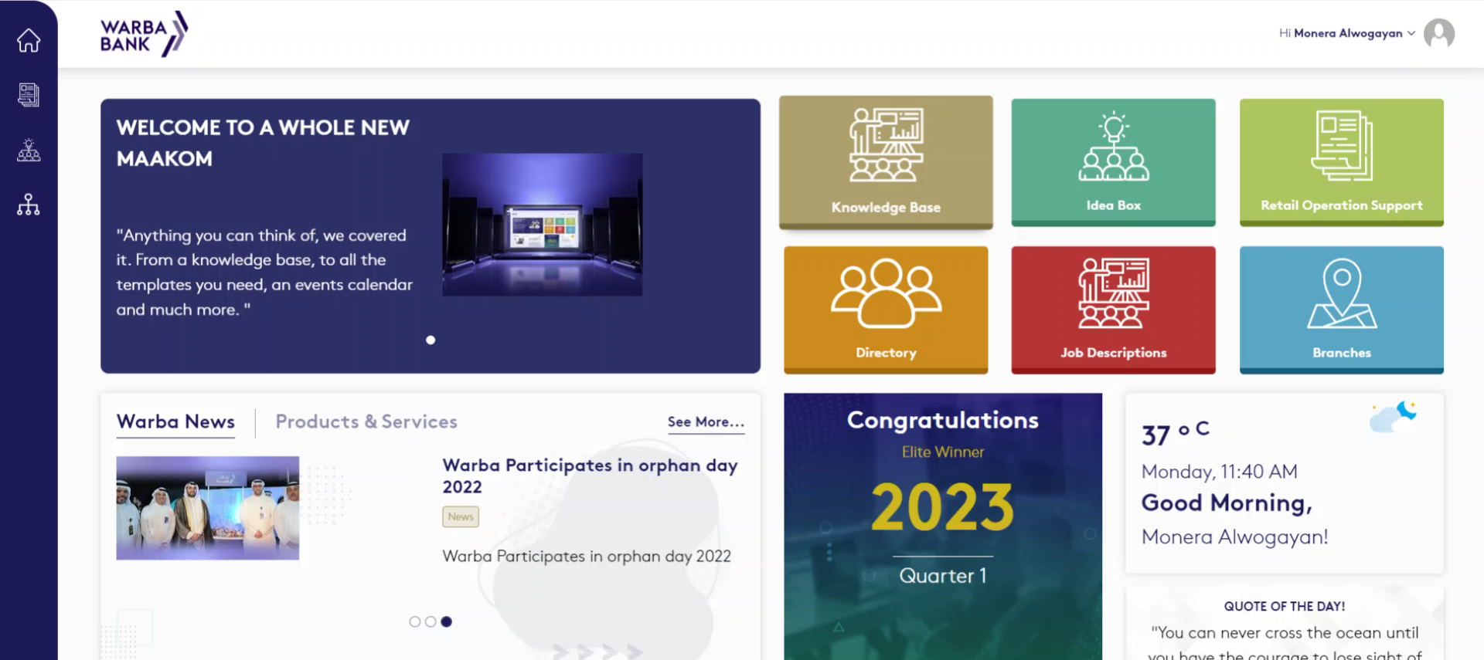
Maakom
Maakom is an initiative to assist Warba employees and educate them on Warba products and services
Warba Bank 2023

Slide 4
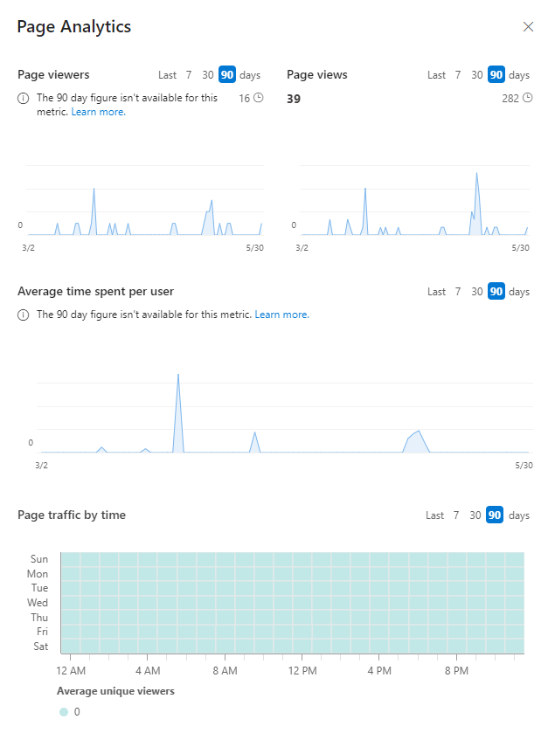
Statistics for Maakom
Warba Bank 2023

Slide 5
Statistics from Warba Staff on Maakom
Unaware
Unaware
31%
56%
56%
No
Yes
No
Yes
Warba Bank 2023

Slide 6
Input from Warba Staff on WB Knowledge
Not easy
Other
Not informed
Other
Other
Somewhat not easy
Daily
Extremely easy
Call Center
2 Minutes
Very informed
1 Hour
A little informed
Warba Staff (Colleague)
Neutral
Warba Website
Monthly
Somewhat easy
Weekly
10 Minutes
5 Minutes
Informed
Warba Bank 2023

Slide 7
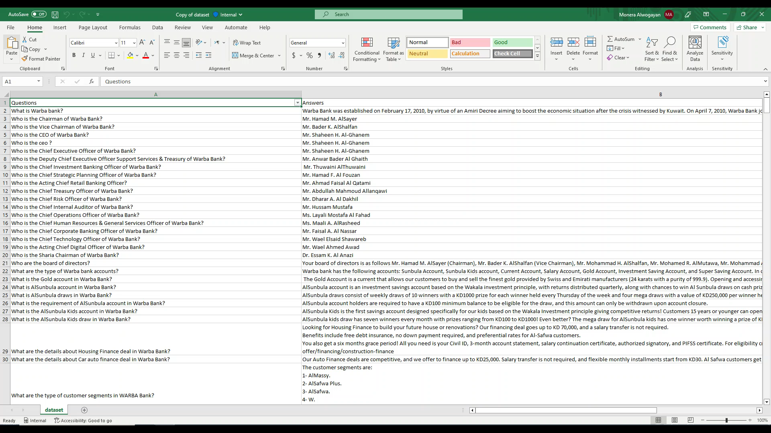
Start of the project
As a first step, we gathered initial information about Warba Bank, its products and services
Using the acquired information, we’ve built a dataset and implemented data preprocessing
Warba Bank 2023

Slide 8
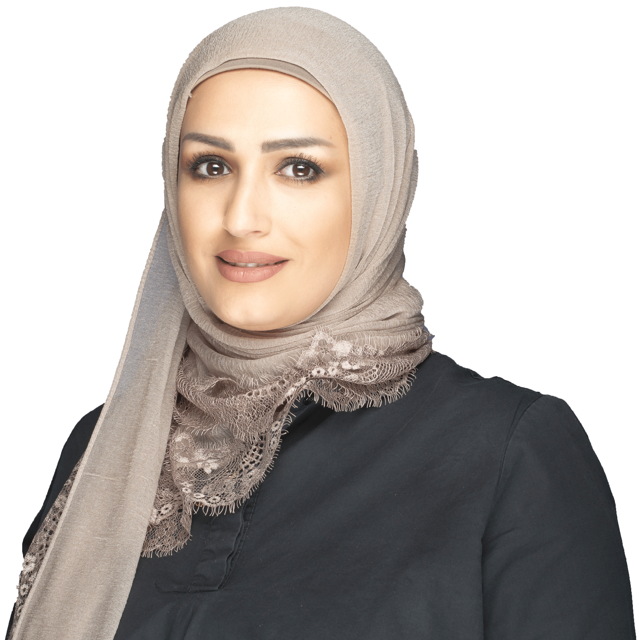




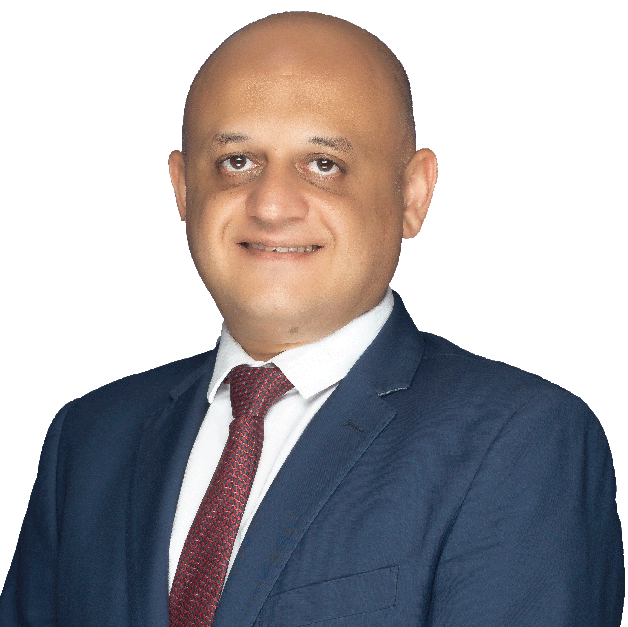

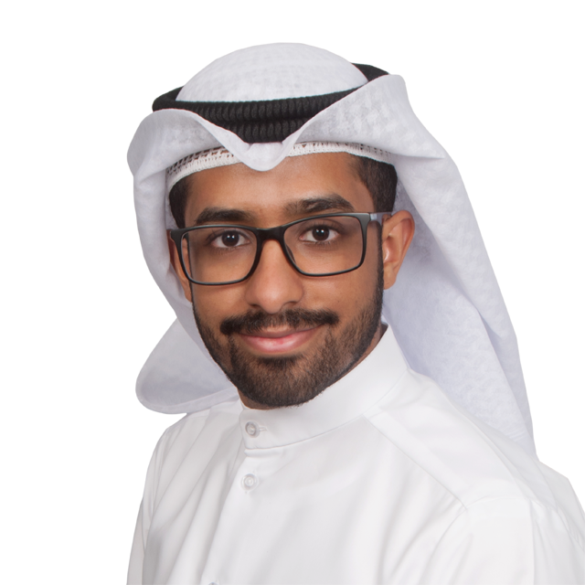
Gathering Data
We’ve met with various teams from RBG, from call center team, branches, cards team, and customer experience
With every meeting we’ve gathered new input and data trained with compatible algorithms
Call Center Team
Branches Team
CXM Team
Cards Team
Recurring Input
Recurring Input
Recurring Input
Recurring Input
Sunbula Draws
Cashback
Branch Locations
Digital Payments
Credit Card Fees
Card Limits
Housing Finance
Cashback
Fixed Deposits
Concierge
Due Amounts
Required Documents
Oasis Points
Financing
Social Media
Card Delivery
Warba Bank 2023

Slide 9
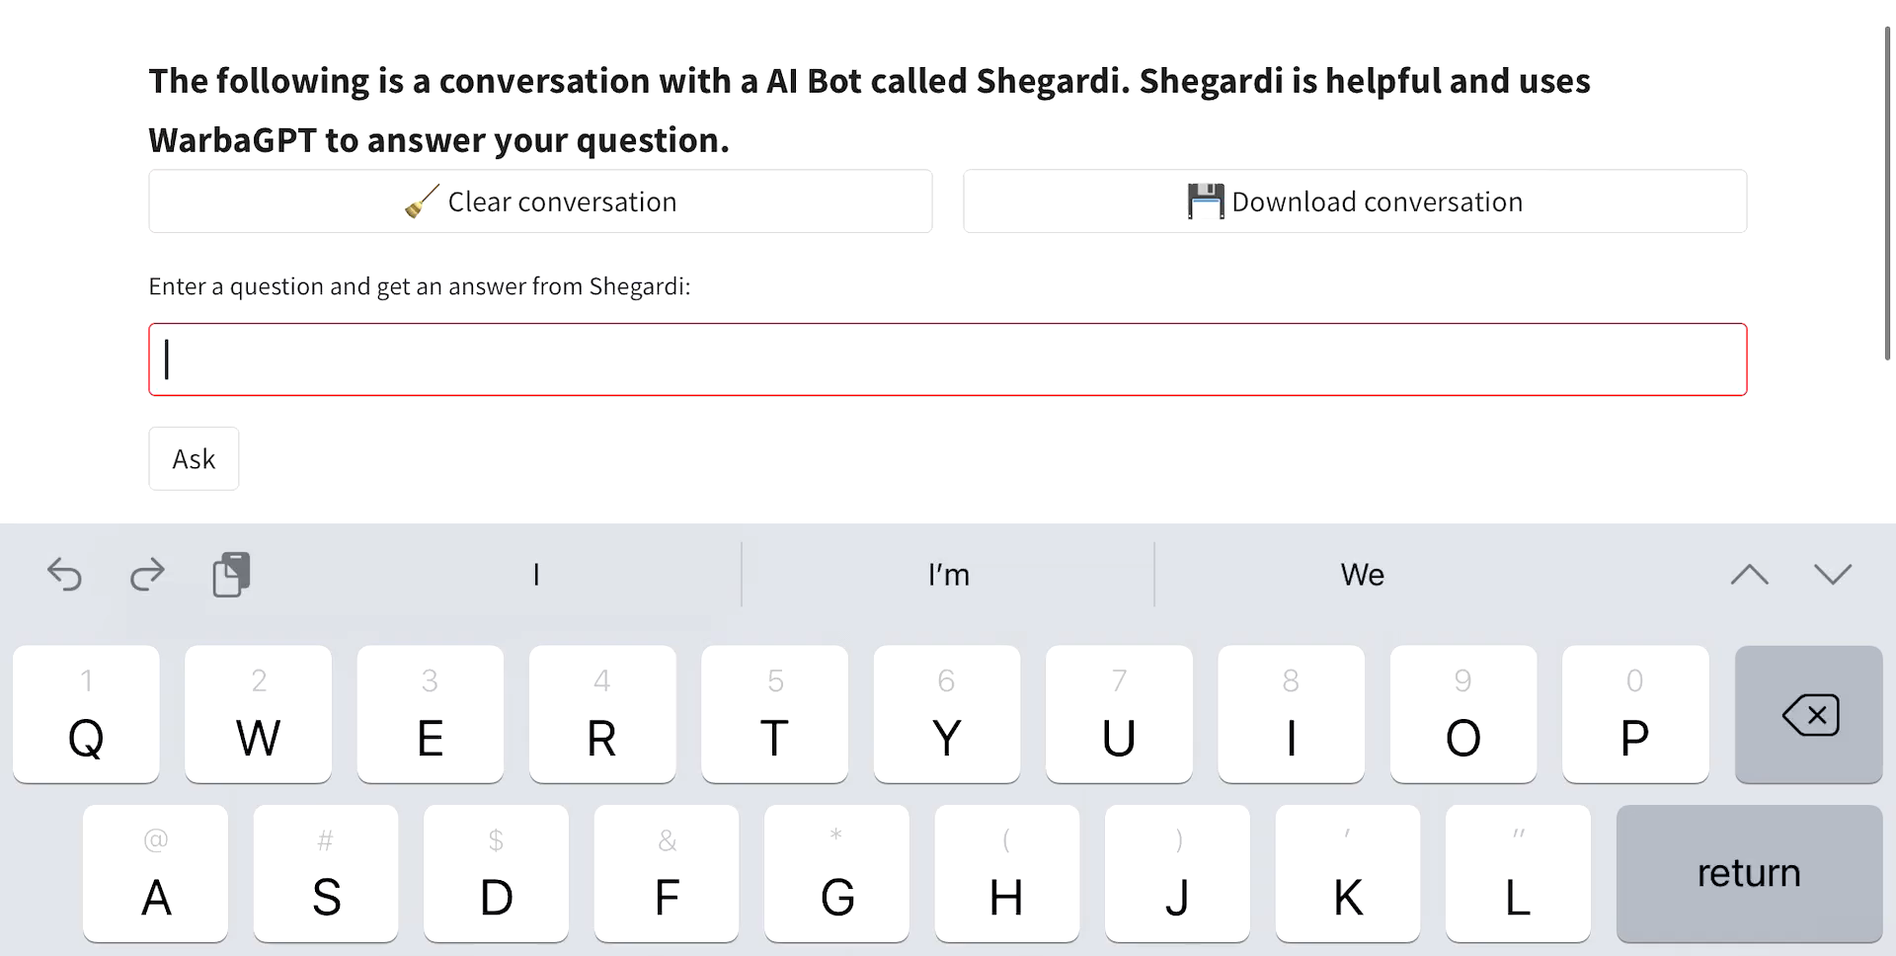
Testing the AI Chat
We’ve continuously tested the AI Chat from other team’s input and feedback
Enhanced the UX and how to formulate the answers
Database generation to collect each user query
Warba Bank 2023

Slide 10
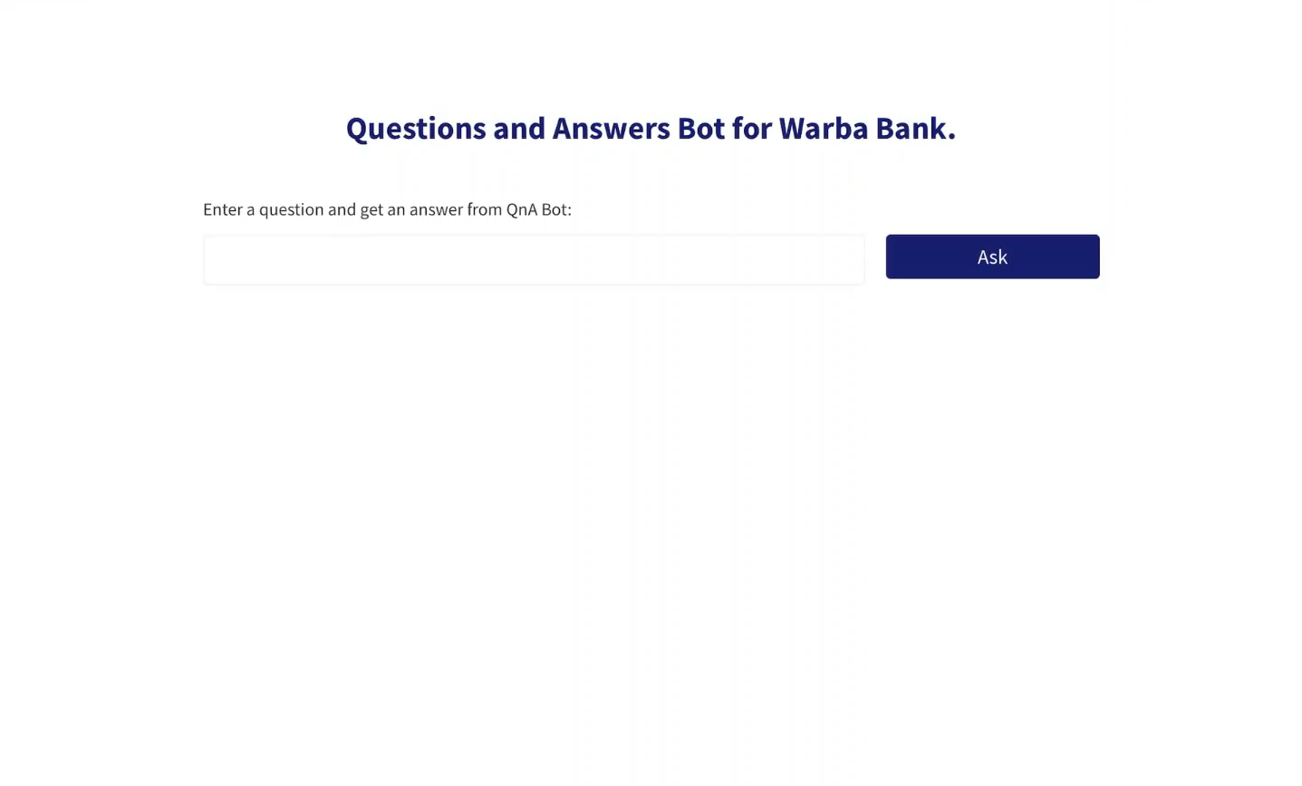
Proposal: Warba AI Chat
Powered by OpenAI’s GPT-3.5-turbo, we’ve built a knowledge base that consolidates information about Warba Bank, its products and services
Warba Bank 2023
Notes:
For Digital Transformation, AR was the first step and AI is what’s next;

Slide 11
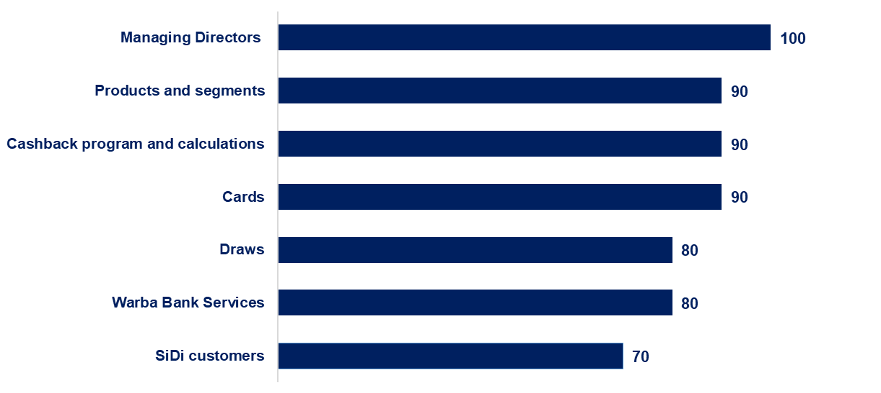
Data Scope and Coverage
Warba Bank 2023

Slide 12
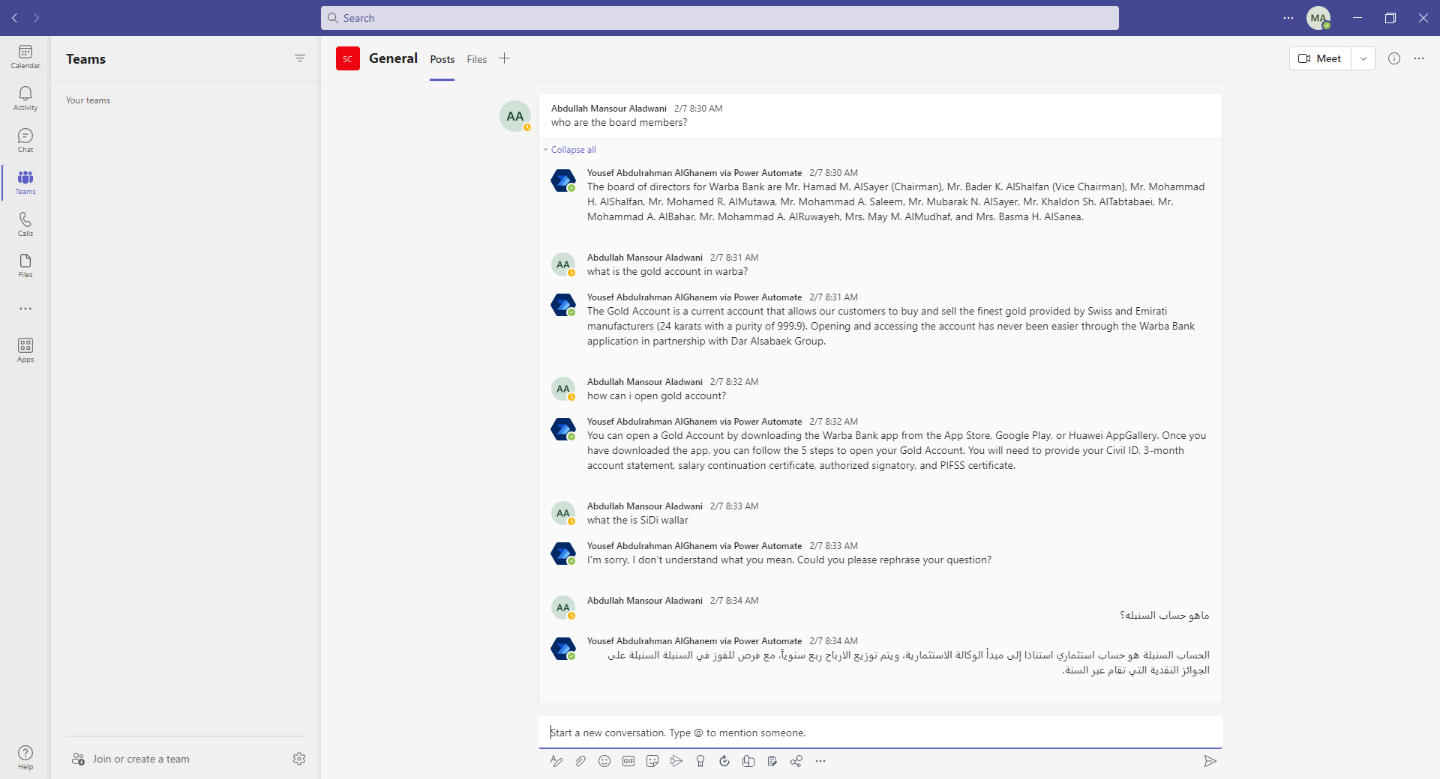
Future for Warba AI Chat
Hosting it on Teams as a channel for easier access and application
Enhancing the development by adding conversational memory to the language model to maintain the context of conversation
Adding Arabic as a second language to further accommodate users
Warba Bank 2023
Notes:
For Digital Transformation, AR was the first step and AI is what’s next;

Slide 13
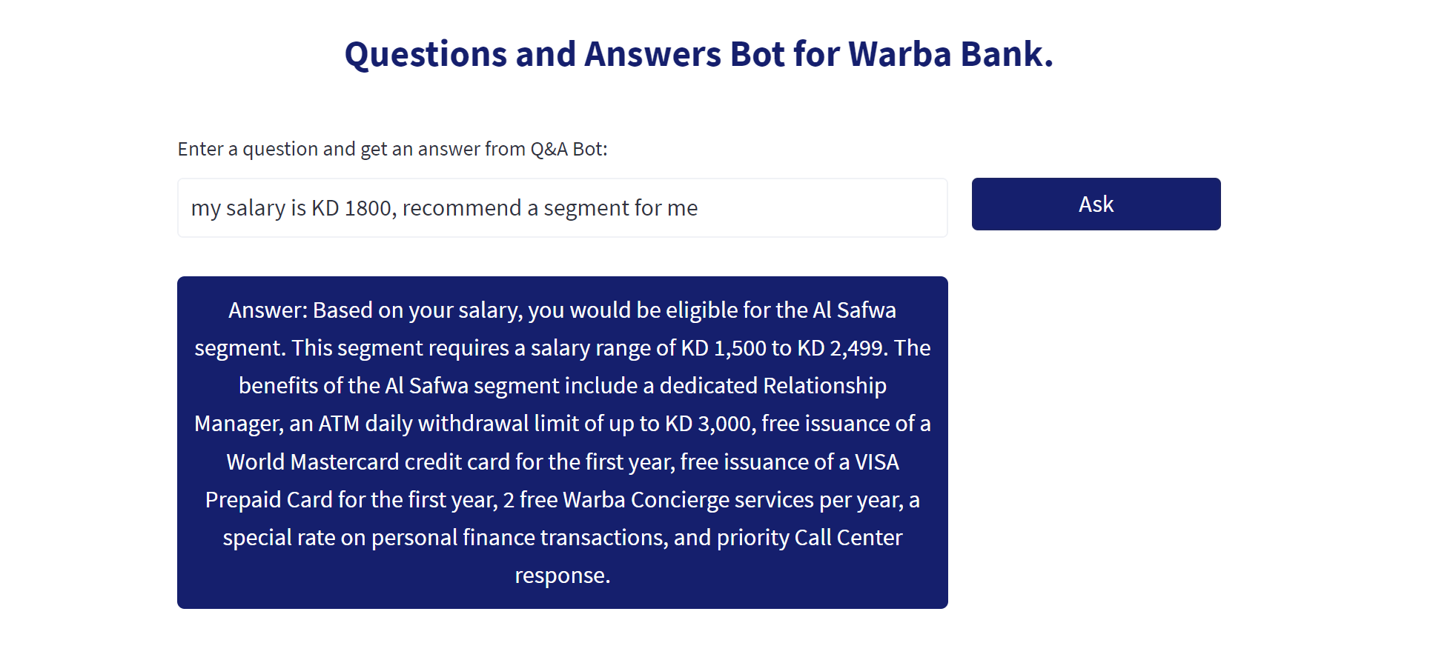
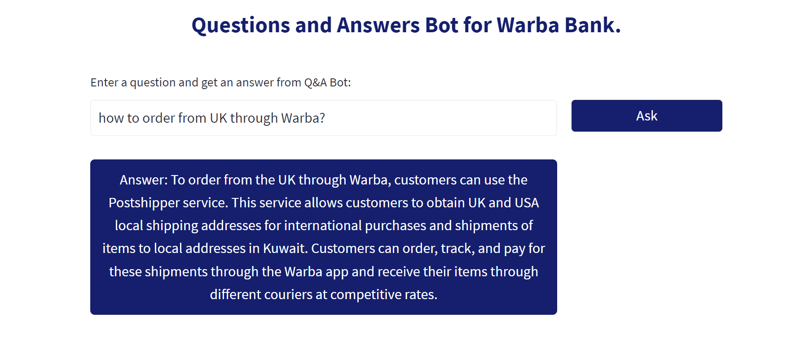
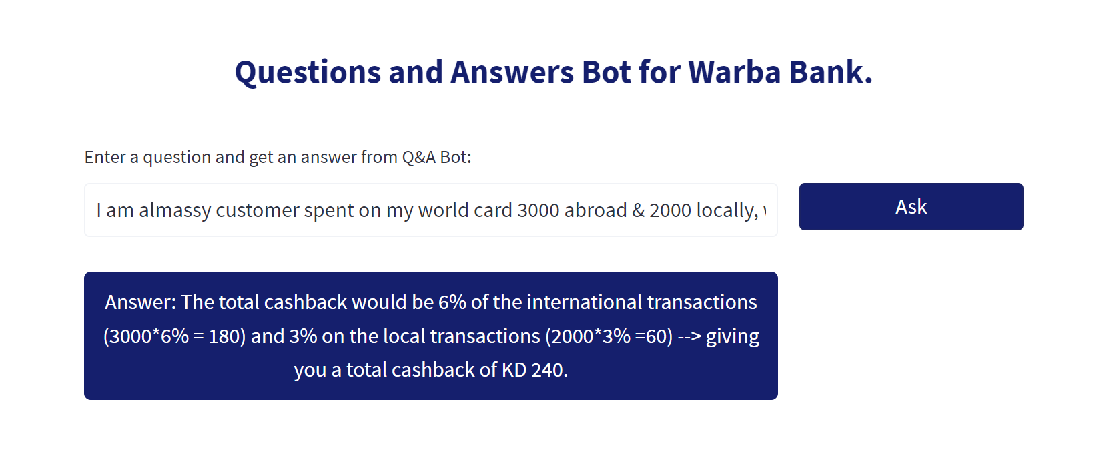
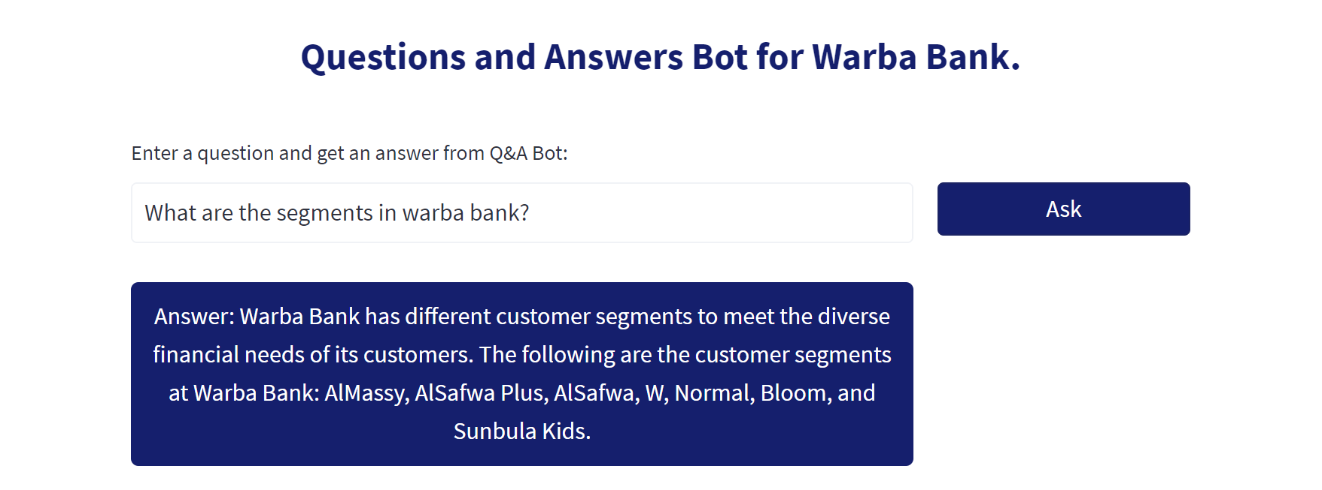
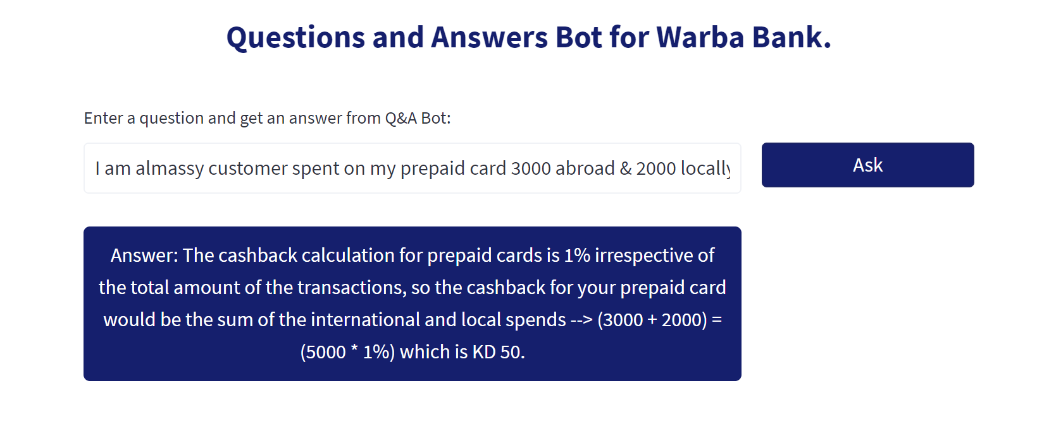
Examples
Warba Bank 2023

Slide 14






Warba AI Benefits:
Improve Customer Loyalty
Reduce Cost
Increase Productivity
Personalized Experience
Speed of Service
Enhanced Monitoring
Warba Bank 2023

Slide 15





Opportunity for Warba Bank
In line with Warba Bank’s values to innovate and to always improve the experience of our customers (Internal and External)
Warba AI Chat can open doors for many advantages
Knowledge Base
Data
AI Assistant
HR Onboarding
BaaS
Warba Bank 2023
Notes:
Fraud Detection and Management
Trading
Managing Finance
Financial Advisory services

Slide 16
Thank You

