Slide 1
Warba Bank Chatbot Powered by ChatGPT

Slide 2
Agenda: 1. Introduction 2. Methodology 3. Dataset Scope 4. Cases Examples 5. Current situation 6. Future Directions

Slide 3
Introduction
Developing chatbots nowadays would facilitate work and enhance the customer service experience and generate a better knowledge for staff and customers.
Chatbots can provide instant response for different queries to provide customer satisfaction.
Chatbots assist humans through interactive conversation. In our demo, we've focused on the development of a Q&A Bot .
Chatbots can be programmed to understand multiple languages and respond in the customer desired language.
© Warba Bank 2018 | Title of presentation
24th January 2018 | Page Number #

Slide 4
Methodology
Collecting the dataset from different departments
Data preprocessing
Data training with compatible algorithms
Database generation to collect each user query
Deployment internally with simple UX/UI
© Warba Bank 2018 | Title of presentation
24th January 2018 | Page Number #

Slide 5
Dataset Scope
Managing Directors (100%) with lines( progress bar).
Products and segments
WARBA Bank Services
Cashback program and calculations
Warba Bank Accounts
Cards
Draws
SiDi customers
© Warba Bank 2018 | Title of presentation
24th January 2018 | Page Number #

Slide 6
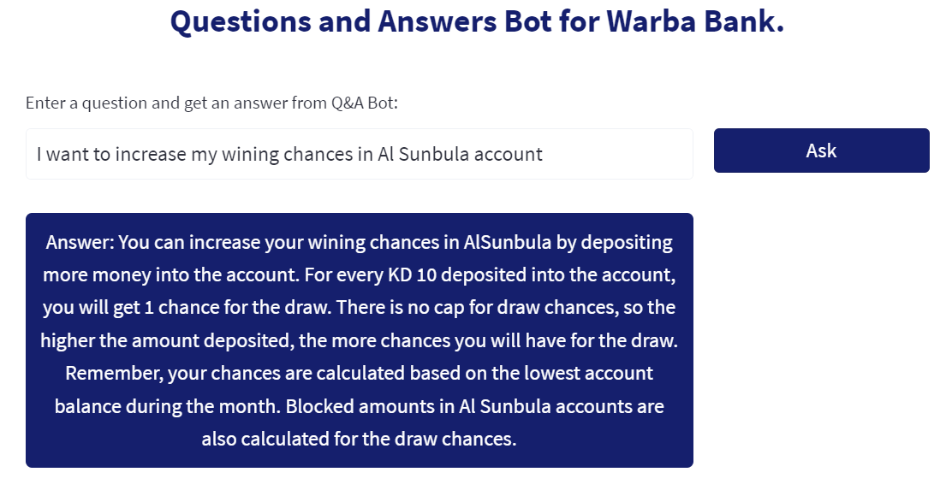
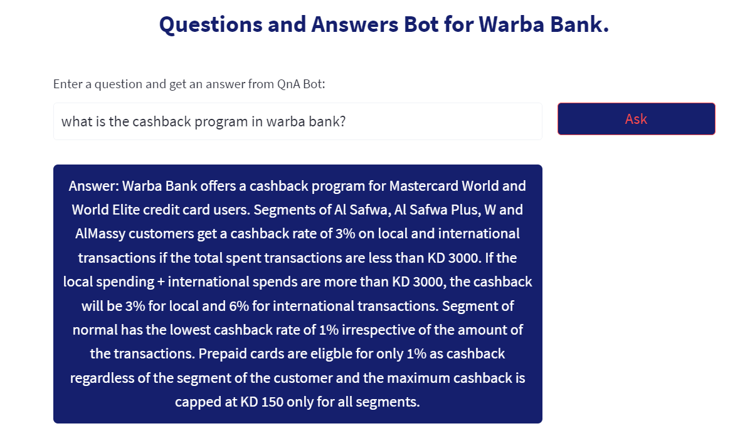
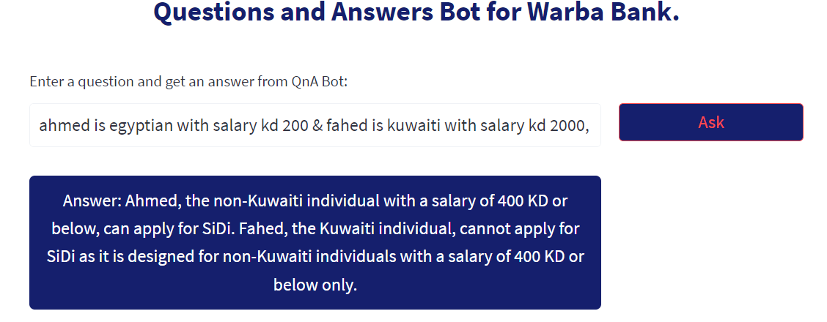
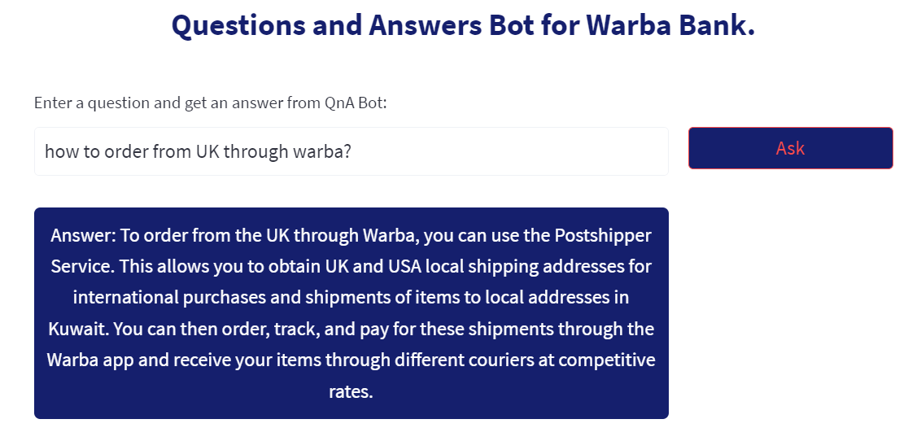
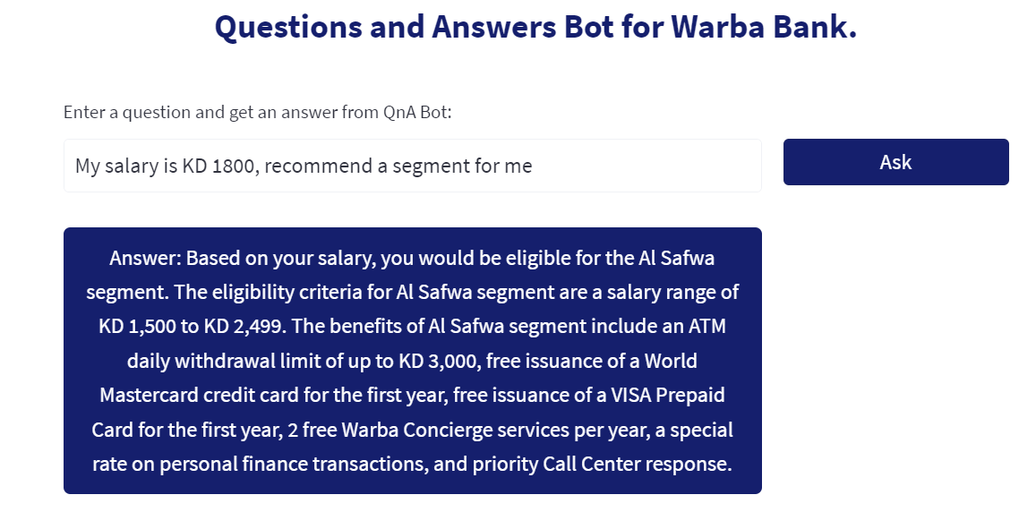
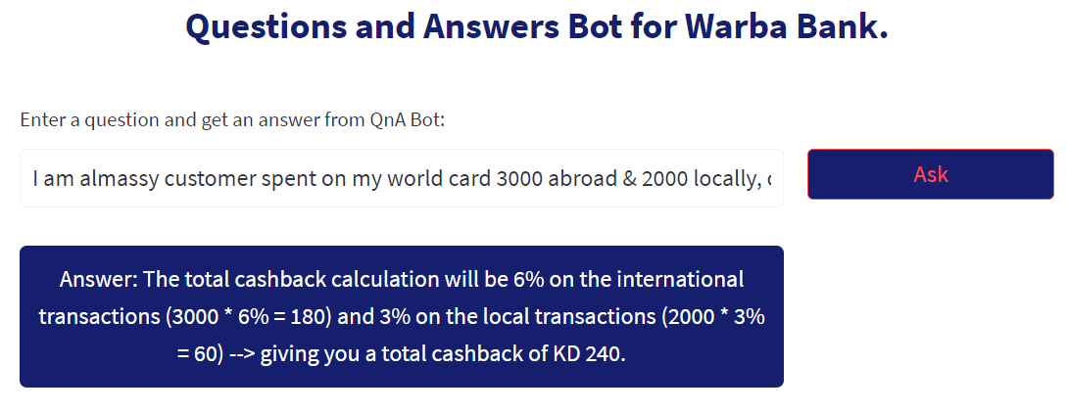
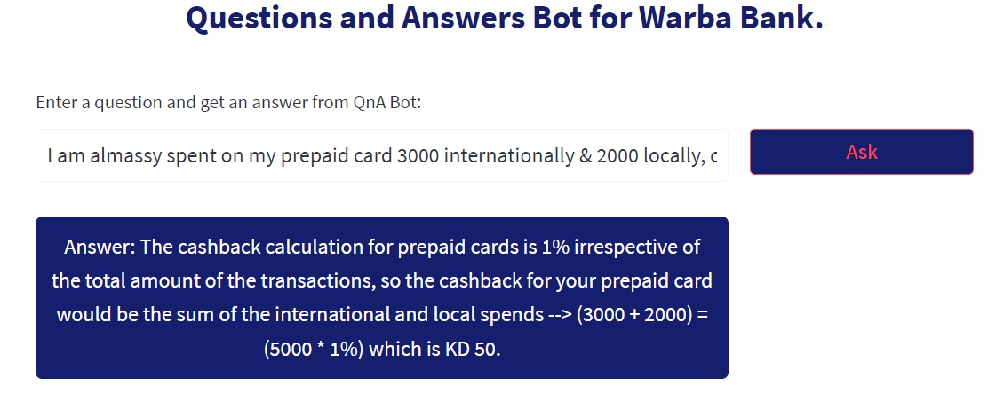
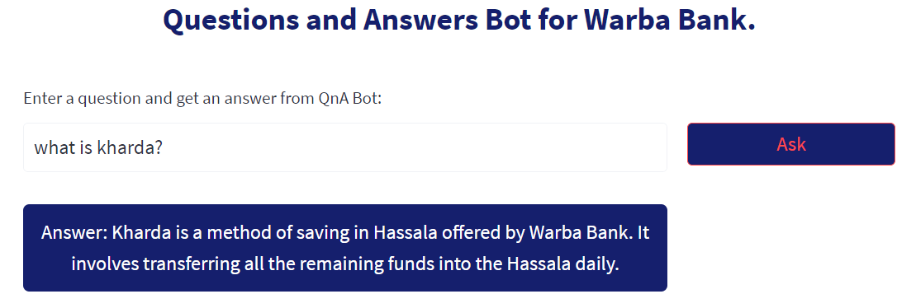
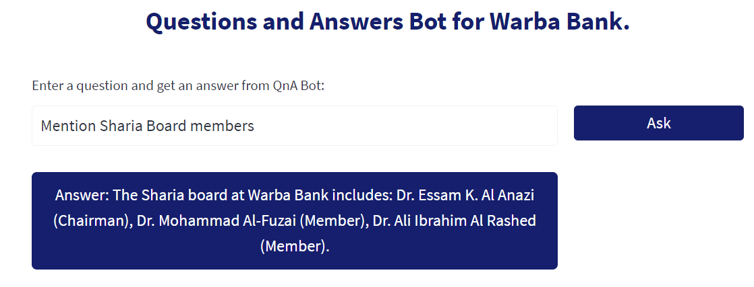
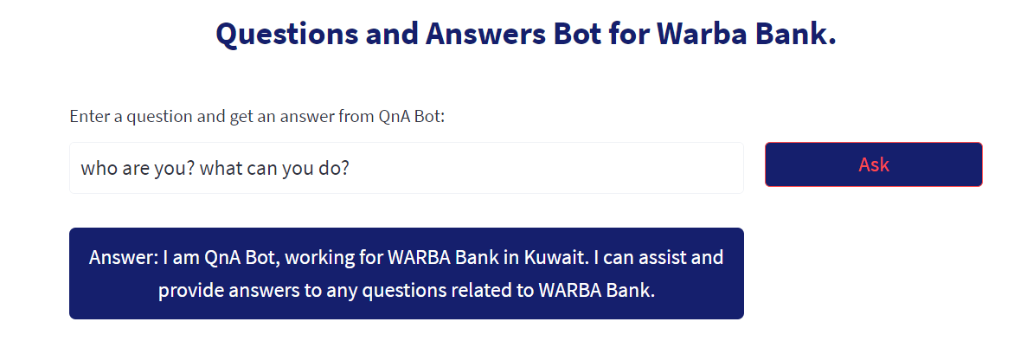
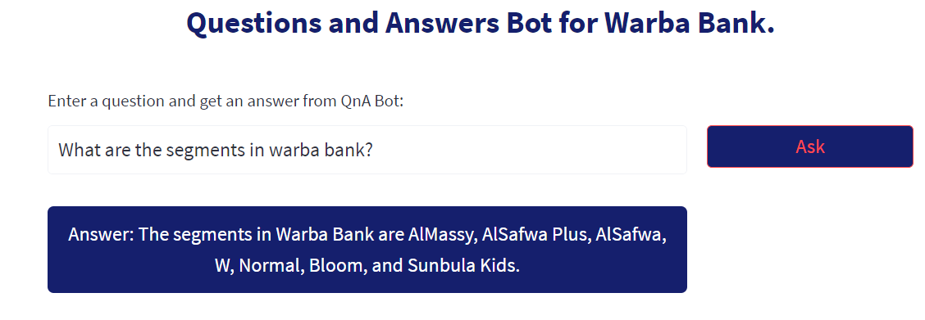
Examples
© Warba Bank 2018 | Title of presentation
24th January 2018 | Page Number #

Slide 7
Current Situation
The chatbot currently works as a Q & A (Questions and Answers).
English text to text language model.
Deployed internally using local environments and tested by different STAFF members.
Demo: https://ahmedewis-shegardi-chatbot-app-70rttq.streamlit.app/
© Warba Bank 2018 | Title of presentation
24th January 2018 | Page Number #

Slide 8
Upcoming plans
Enhance the developed chatbot by adding conversational memory to the language model to maintain the context of conversation.
This will change the phase from Q & A to a conversation between the user and the chatbot.
Adding different languages, so that the chatbot will answer with the language entered by the user. (Arabic, Hindi, Filipino, Chinese, etc).
© Warba Bank 2018 | Title of presentation
24th January 2018 | Page Number #

Slide 9
Thank you!

